Slide 1

T03 Build a DevOps Culture: Microsoft's Journey to Adopt an Agile Mindset and DevOps
Mickey Gousset
DevOps Architect
Microsoft
Level: Introductory

Slide 2












DevOps CAT team mission
Work with Microsoft’s largest customers to help them accelerate their DevOps transformation.

Slide 3
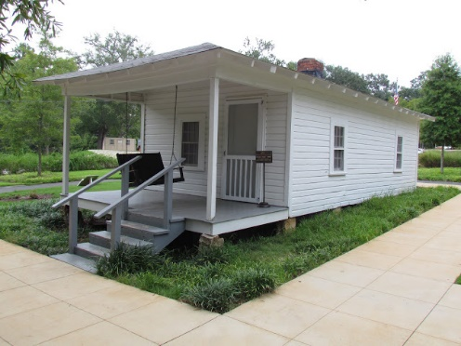

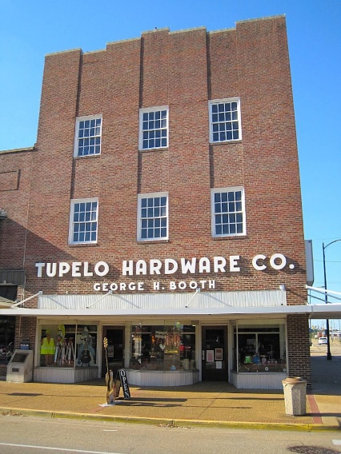
What is Tupelo, MS world-famous for?

Slide 4
Accelerating Delivery with DevOps
Develop
“
DevOps is the union of people, process, and products to enable continuous delivery of value to your end users.
”
DevOps
Operate
Deliver
Notes:
DevOps allows us to accelerate delivery, while still delivering reliable products and services
This is about bringing people together, through shared common goals, increased collaboration and a focus on improvement
Technology plays a key role in helping to execute a DevOps strategy by enabling teams to collaborate more, enhance productivity, facilitate experimentation and automate their processes from development, through to delivery and operations
It’s also about delivering value faster by increasing efficiency, eliminating waste and streamlining feedback back to developers to continuously improve the product
The result: better products, delivered faster, to happier customers
https://medium.com/@DonovanBrown_41367/dissecting-the-definition-69151da0435f

Slide 5
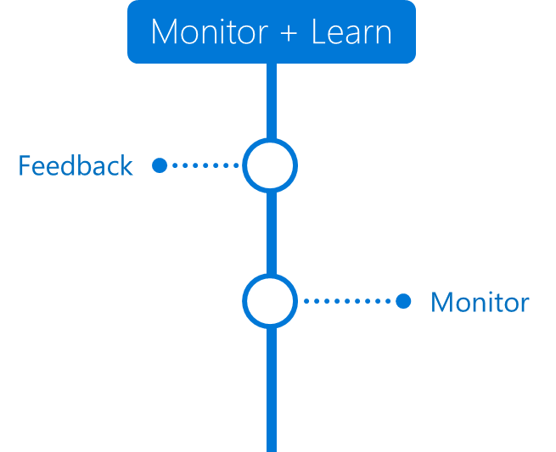

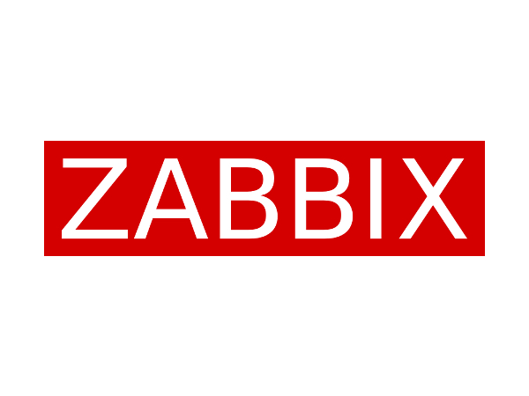



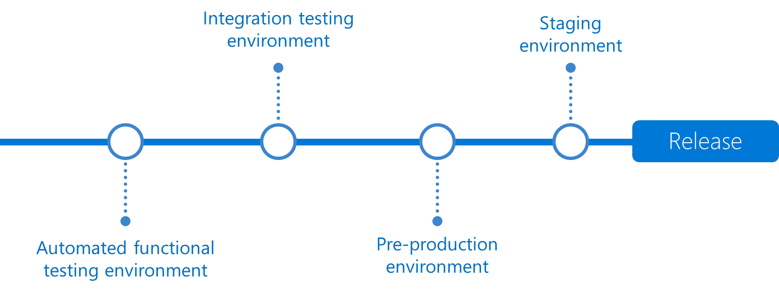
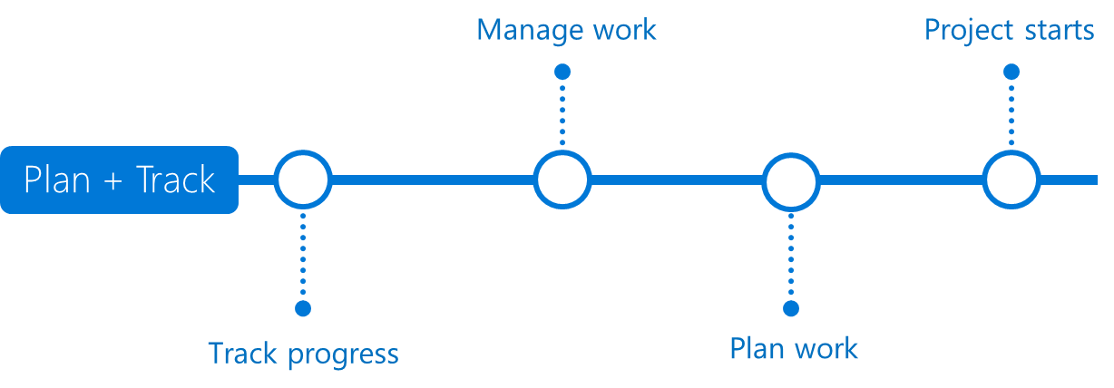



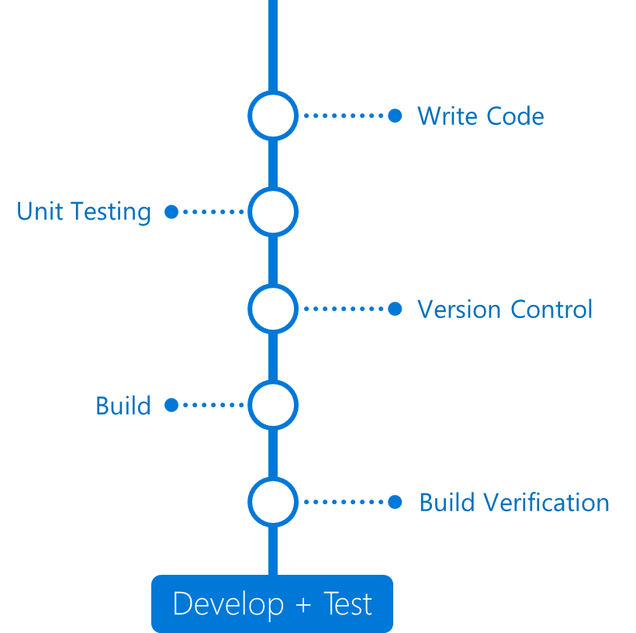
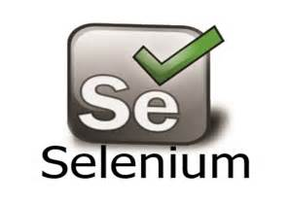

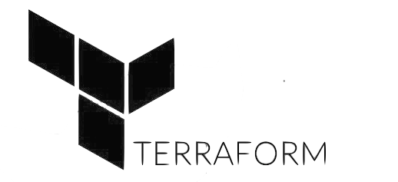























Azure DevOps
Application Insights
Any language, Any Platform
DevOps
DevOps
Visual Studio

Slide 6
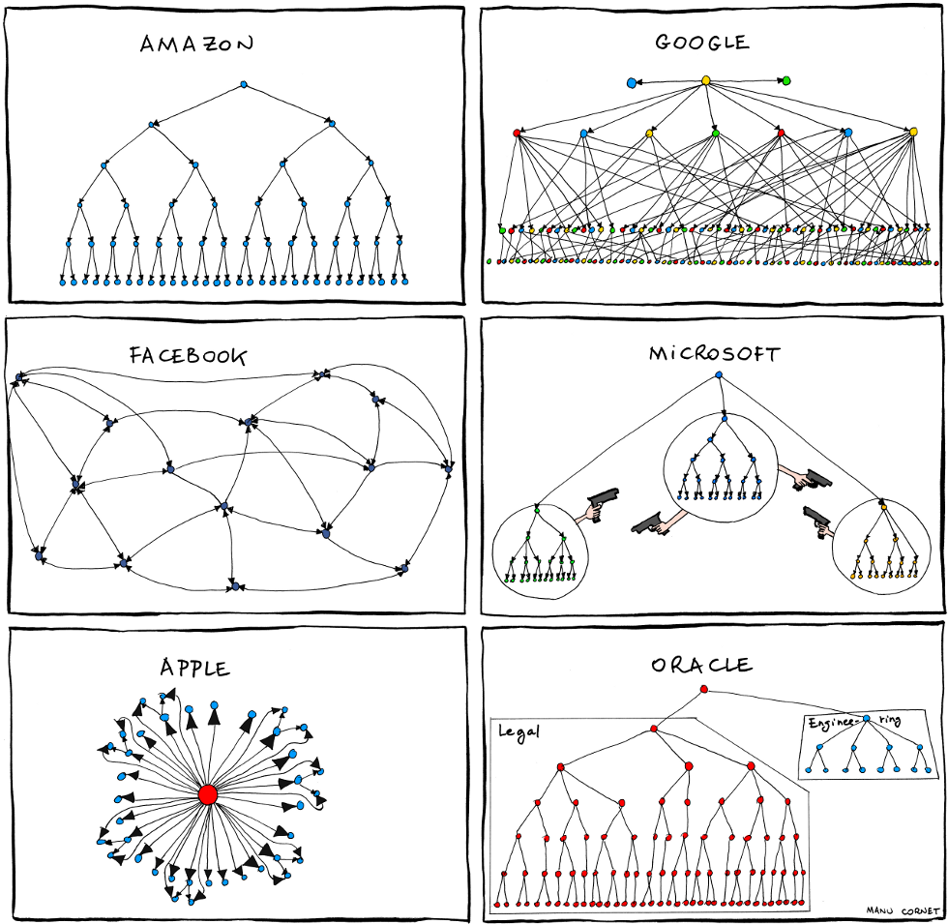
http://www.bonkersworld.net/images/2011.06.27_organizational_charts.png
Notes:
Manu Cornet, works at Google. Org Charts from back in 2011

Slide 7
http://www.bonkersworld.net/images/2011.06.27_organizational_charts.png
Notes:
Manu Cornet, works at Google

Slide 8

One Engineering System using Azure DevOps
There cannot be a more important thing for an engineer, for a product team, than to work on the systems that drive our productivity.
So I would, any day of the week, trade off features for our own productivity.
I want our best engineers to work on our engineering systems, so that we can later on come back and build all of the new concepts we want.
- Satya Nadella

Slide 9

The journey so far
Sprint 161
Nov 2019
VSTS Preview
1ES
Windows on Git
Azure Pipelines
Sprint 140
Sep 2018
Sprint 1
August 2010
Sprint 29
June 2012
Sprint 67
June 2014
Sprint 102
May 2017
2010
2011
2012
2013
2014
2015
2016
2017
2018
2019
2020
400 Open Source Projects
Microsoft on GitHub
VS Code
GitHub Acquired
March 2010
July 2014
April 2015
Join Linux Foundation
Nov 2016
Oct 2018
8.8k open source projects 25k employees contributing

Slide 10
DevOps inside Microsoft
➔
https://aka.ms/DevOpsAtMicrosoft
110k
Active users inside Microsoft
4.6m
Builds per month
28k
Work items created per day
82,000
Deployments per day
2.4m
Private Git commits per month
8.8k Open Source repos on GitHub
25k
Employees contributing to open source
Data: Internal Microsoft engineering system activity, Sept 2019

Slide 11
Five habits we’ve learned so far
Customer Obsessed
Production First Mindset
Team Autonomy + Enterprise Alignment
Shift Left Quality
Safe Deployments and Limiting Damage
Notes:
We’re a long way on the journey, and still have a lot to learn. But here are 5 habbits that we’ve learned so far.
Customer Obsessed, Team Autonomy and Shifting Left are basically second decade agile
DevOps brings Product First Mindset and Infrastructure as a Flexible Resource into play
Note that they all result in some inter-related processes. We’ve got to where we are now over a long time, and it’s been a very iterative process.
But we’re not done – we’ve still lots to learn.

Slide 12
Five habits we’ve learned so far
Customer Obsessed
Production First Mindset
Team Autonomy + Enterprise Alignment
Shift Left Quality
Safe Deployments and Limiting Damage
Notes:
But first let’s talk about what I mean by being Customer Obsessed. That starts by our very definition of what DevOps is…

Slide 13
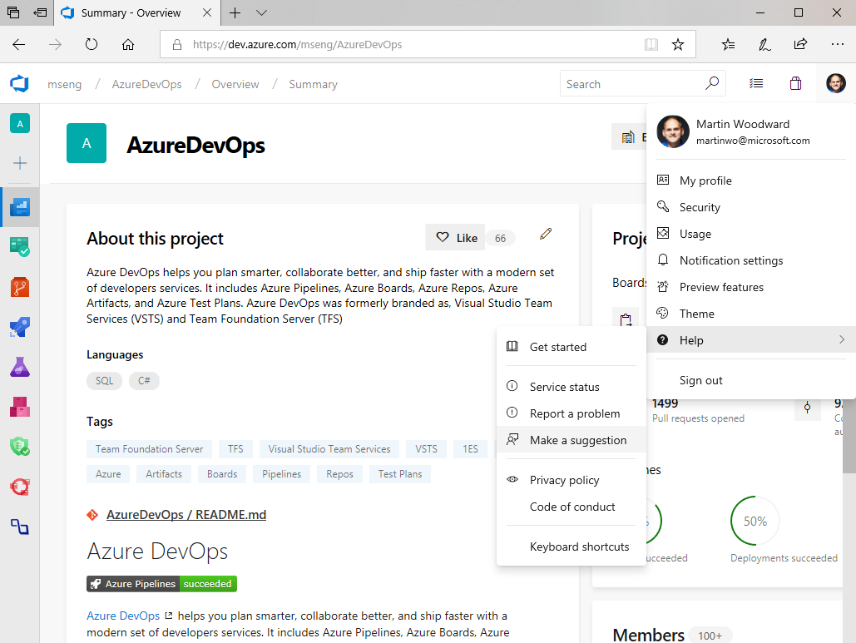
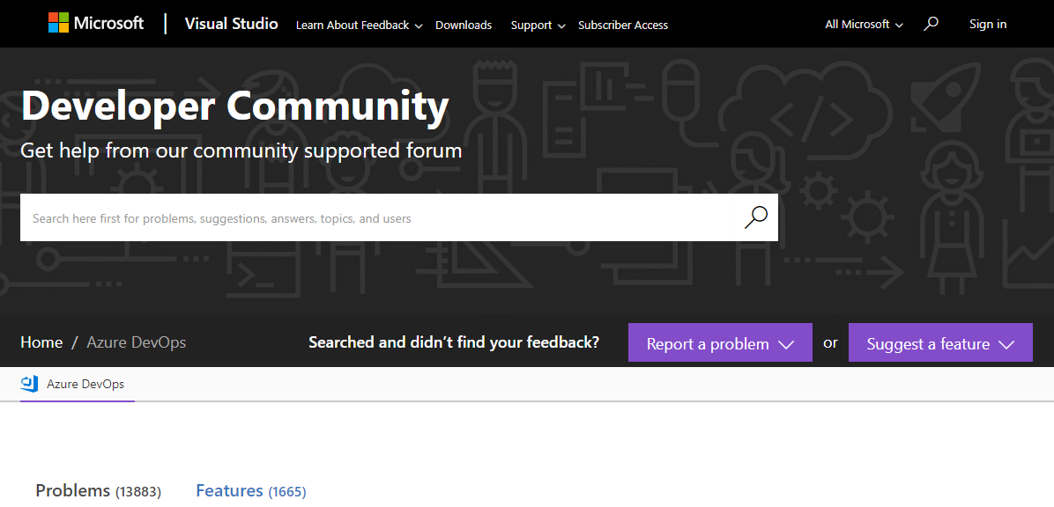
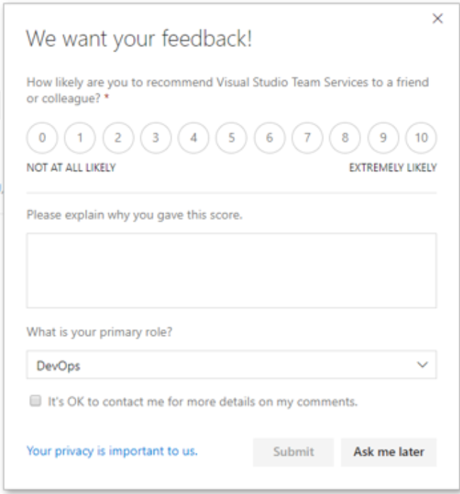
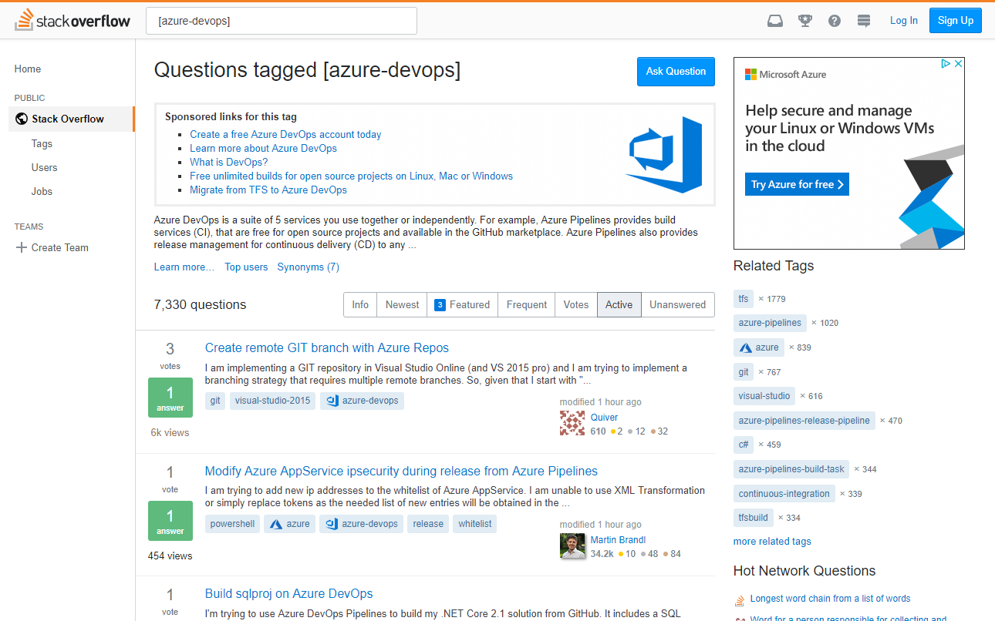
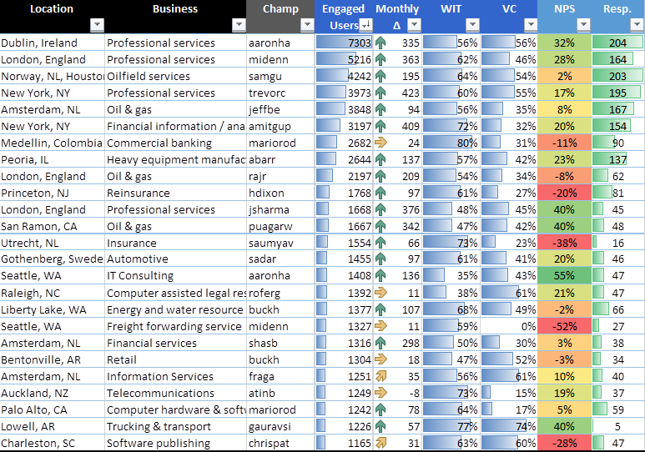
Listen to our customers
Quantitively & Qualitatively
Notes:
In FY’20 Q1, Azure DevOps implemented necessary changes to NPS in order to improve the statistical relevance of the scores representing the services. The initial change was to shift from a blanket prompt approach to service specific prompt-rates. The results of this change are currently normalizing to create consistent NPS trends for Artifacts and Test Plans. The second major change to NPS was the approach Azure DevOps uses to calculate the suite’s NPS. Originally, the score was calculated on general suite pages, such as the project home page. However, this has been changed to be a holistic calculation of all NPS scores gathered across all Azure DevOps pages and services. As of September, this new calculation is now represented within the Azure DevOps NPS dashboard.
I believe we migrated off of UserVoice so that we could have a seamless experience of capturing issues and suggestions in one place while also having Azure DevOps work item integration for our engineering teams. The integration allows our teams to communicate with customers and plan things into sprints without having to leave the Azure DevOps work item experience.

Slide 14
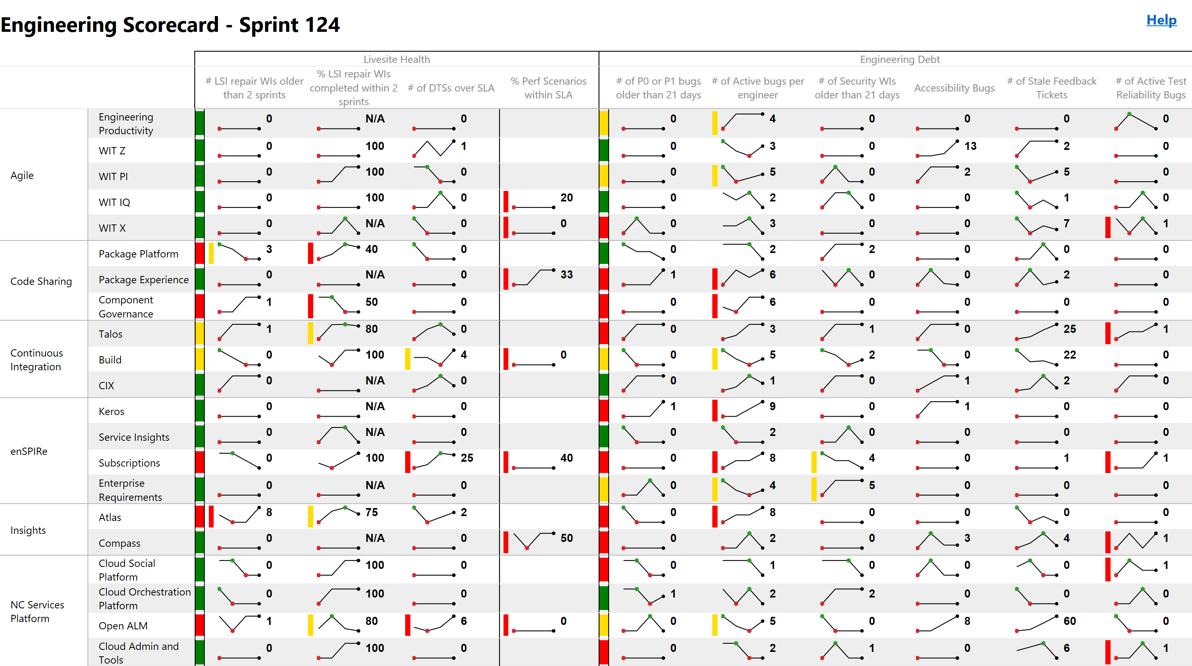
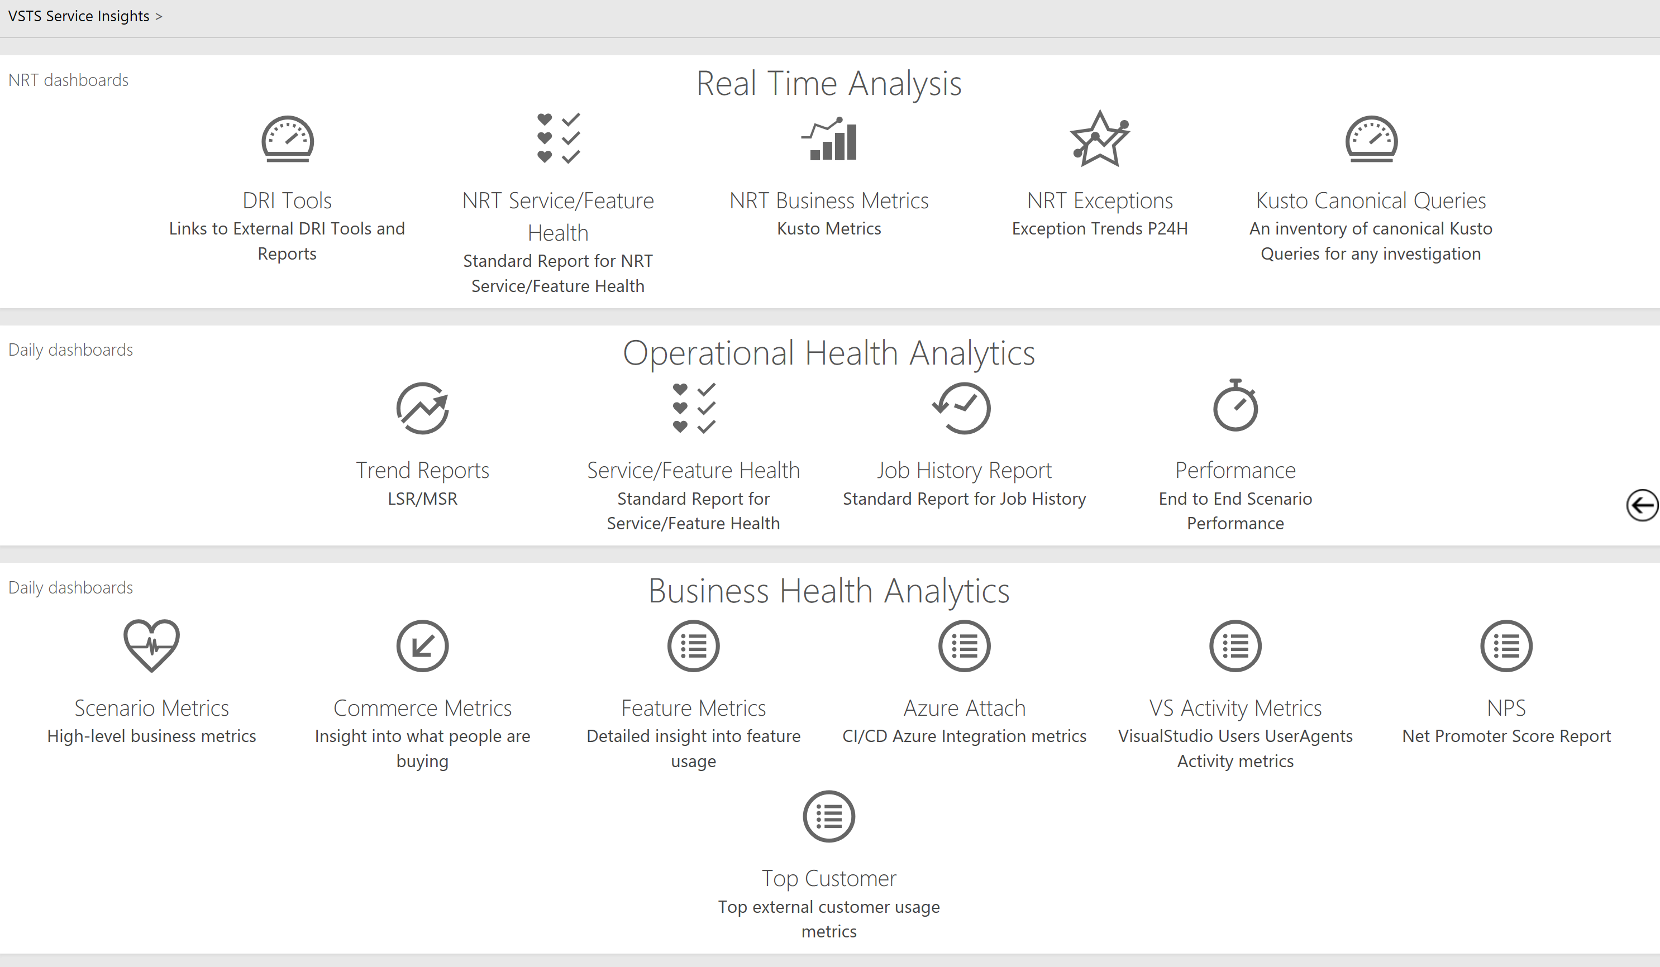
You get what you measure (Don’t measure what you don’t want)
Customer Usage
Acquisition
Retention
Engagement
Satisfaction (NPS)
Feature Usage
Live Site Health
Things we don’t watch
Time to Detect
Time to Communicate
Time to Mitigate
Which customers affected
Incident Prevention Items
Aging Prevention Items
SLA per Customer
Customer Support Metrics
Original estimate
Completed hours
Lines of Code
Team capacity
Team burndown
Team story point velocity
# of bugs found
% code coverage
Pipeline Velocity
Time to Build
Time to Test
Time to Deploy
Time to Improve
Failed and flaky automation

Slide 15

Build-Measure-Learn
Hypothesis
We believe {customer segment} wants {product/feature} because {value prop}
Experiment
To prove or disprove the above, the team will conduct the following experiment(s): …
Learning
The above experiment(s) proved or disproved the hypothesis by impacting the following metric(s): …

Slide 16
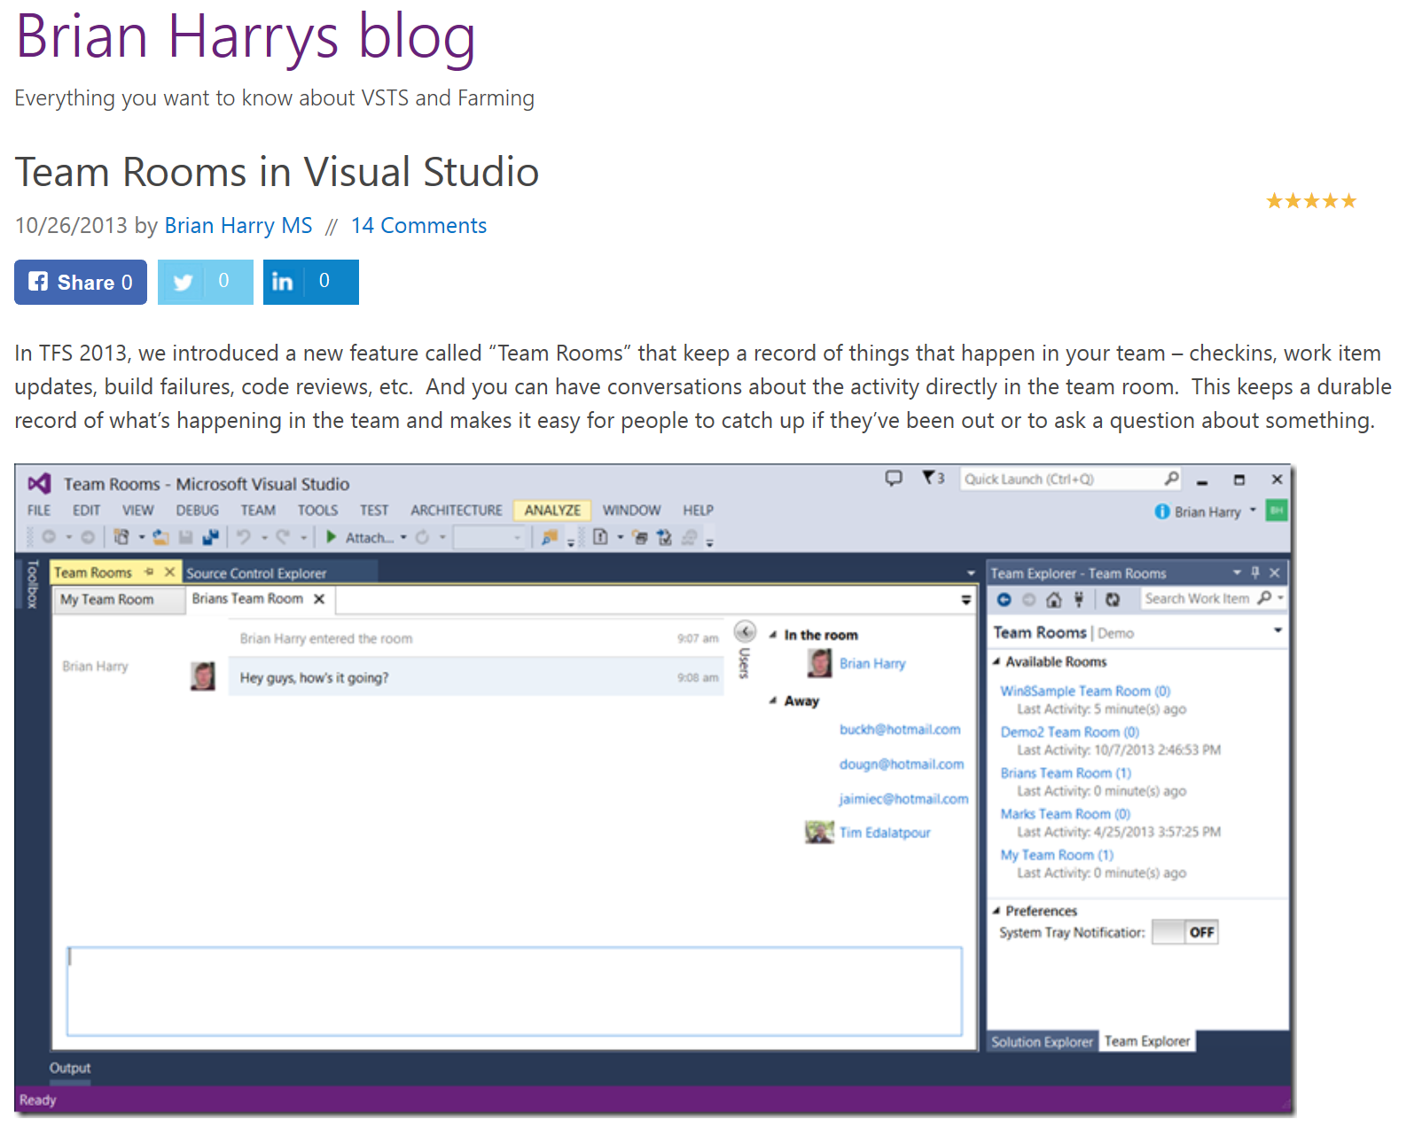
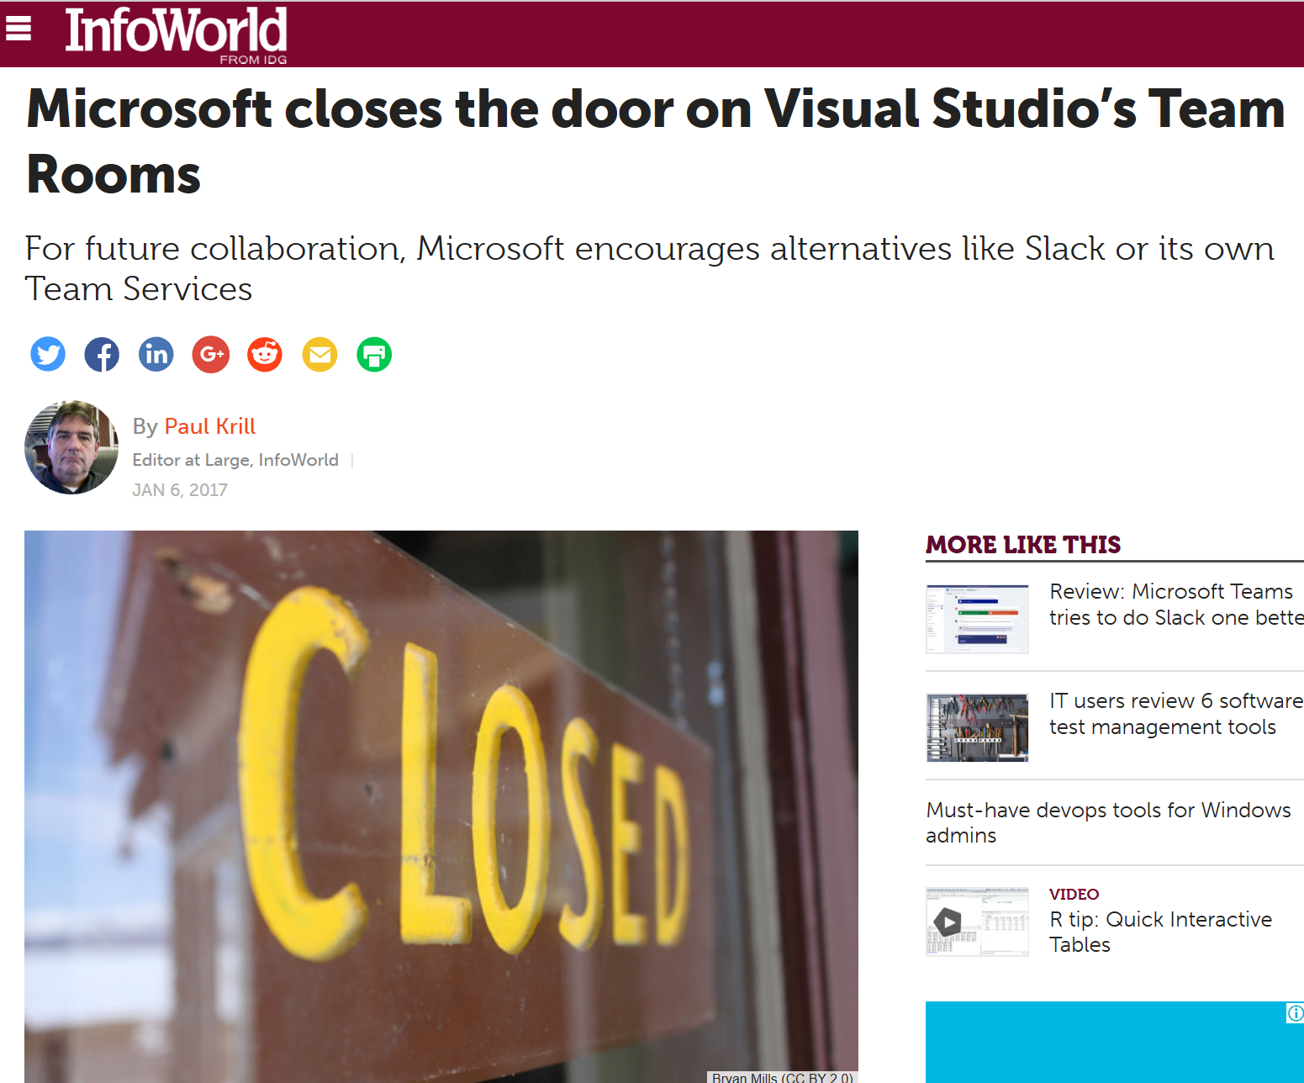
Failure is an opportunity to learn
Notes:
Listening to our customers is important. Sometimes that doesn’t have the results we hoped. For example we heard from our customers that we needed enterprise-social features built into the product. We evaluated the hypothesis, designed the experience (Team Rooms) and then learnt (over time) that our customers looked at it but then rarely ever used it. After investigating why usage was well below expectations, we eventually removed the feature from the product allowing us to focus our efforts in other areas.

Slide 17
Five habits we’ve learned so far
Customer Obsessed
Production First Mindset
Team Autonomy + Enterprise Alignment
Shift Left Quality
Safe Deployments and Limiting Damage

Slide 18
Our Definition of Done
Live in production,
collecting telemetry
supporting or diminishing the starting hypothesis.

Slide 19
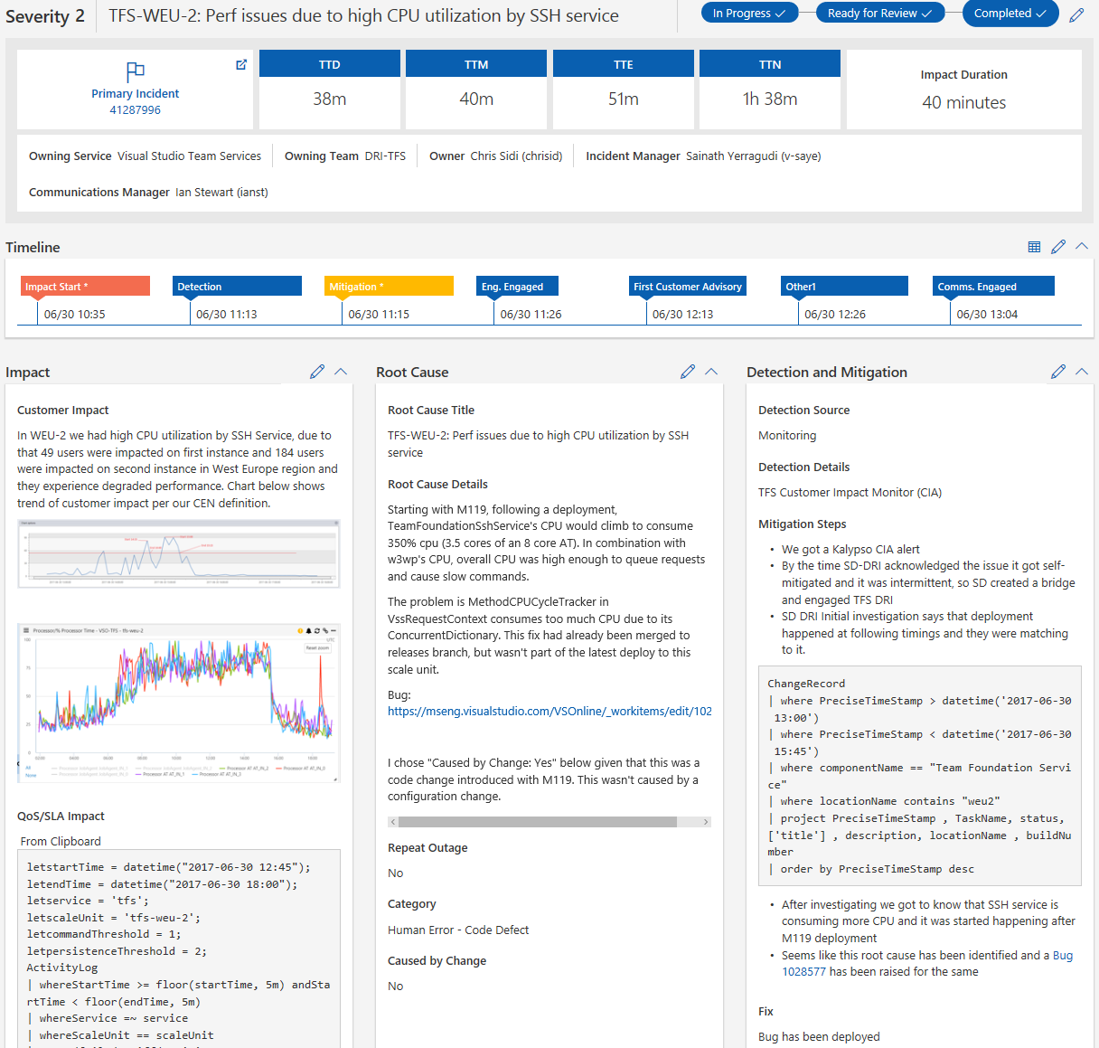
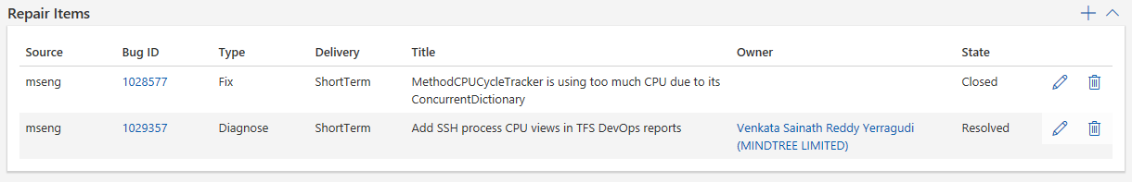
Live Site Incidents
On detection, LSI conference bridge created
DRI’s brought in to call
Communication externally and internally
Gather data for repair items & mitigate for customers
Every action recorded
Plan to rotate people during long running LSI’s
Create & track repair Items to prevent reoccurrence and improve detection time

Slide 20
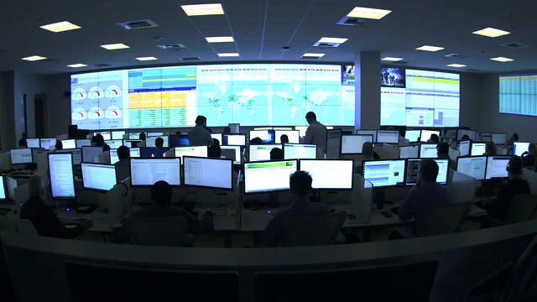
Live Site Culture
Live site status is always the top priority
Weekly live site review
Closing LSI requires listing repair items
LSI repair items in backlog (2 sprint rule)
Actionable alerts
Monthly service review
On-call Designated Responsible Individual (DRI)
Customer Obsessed Availability model (SLA)
Per team / service health reports

Slide 21
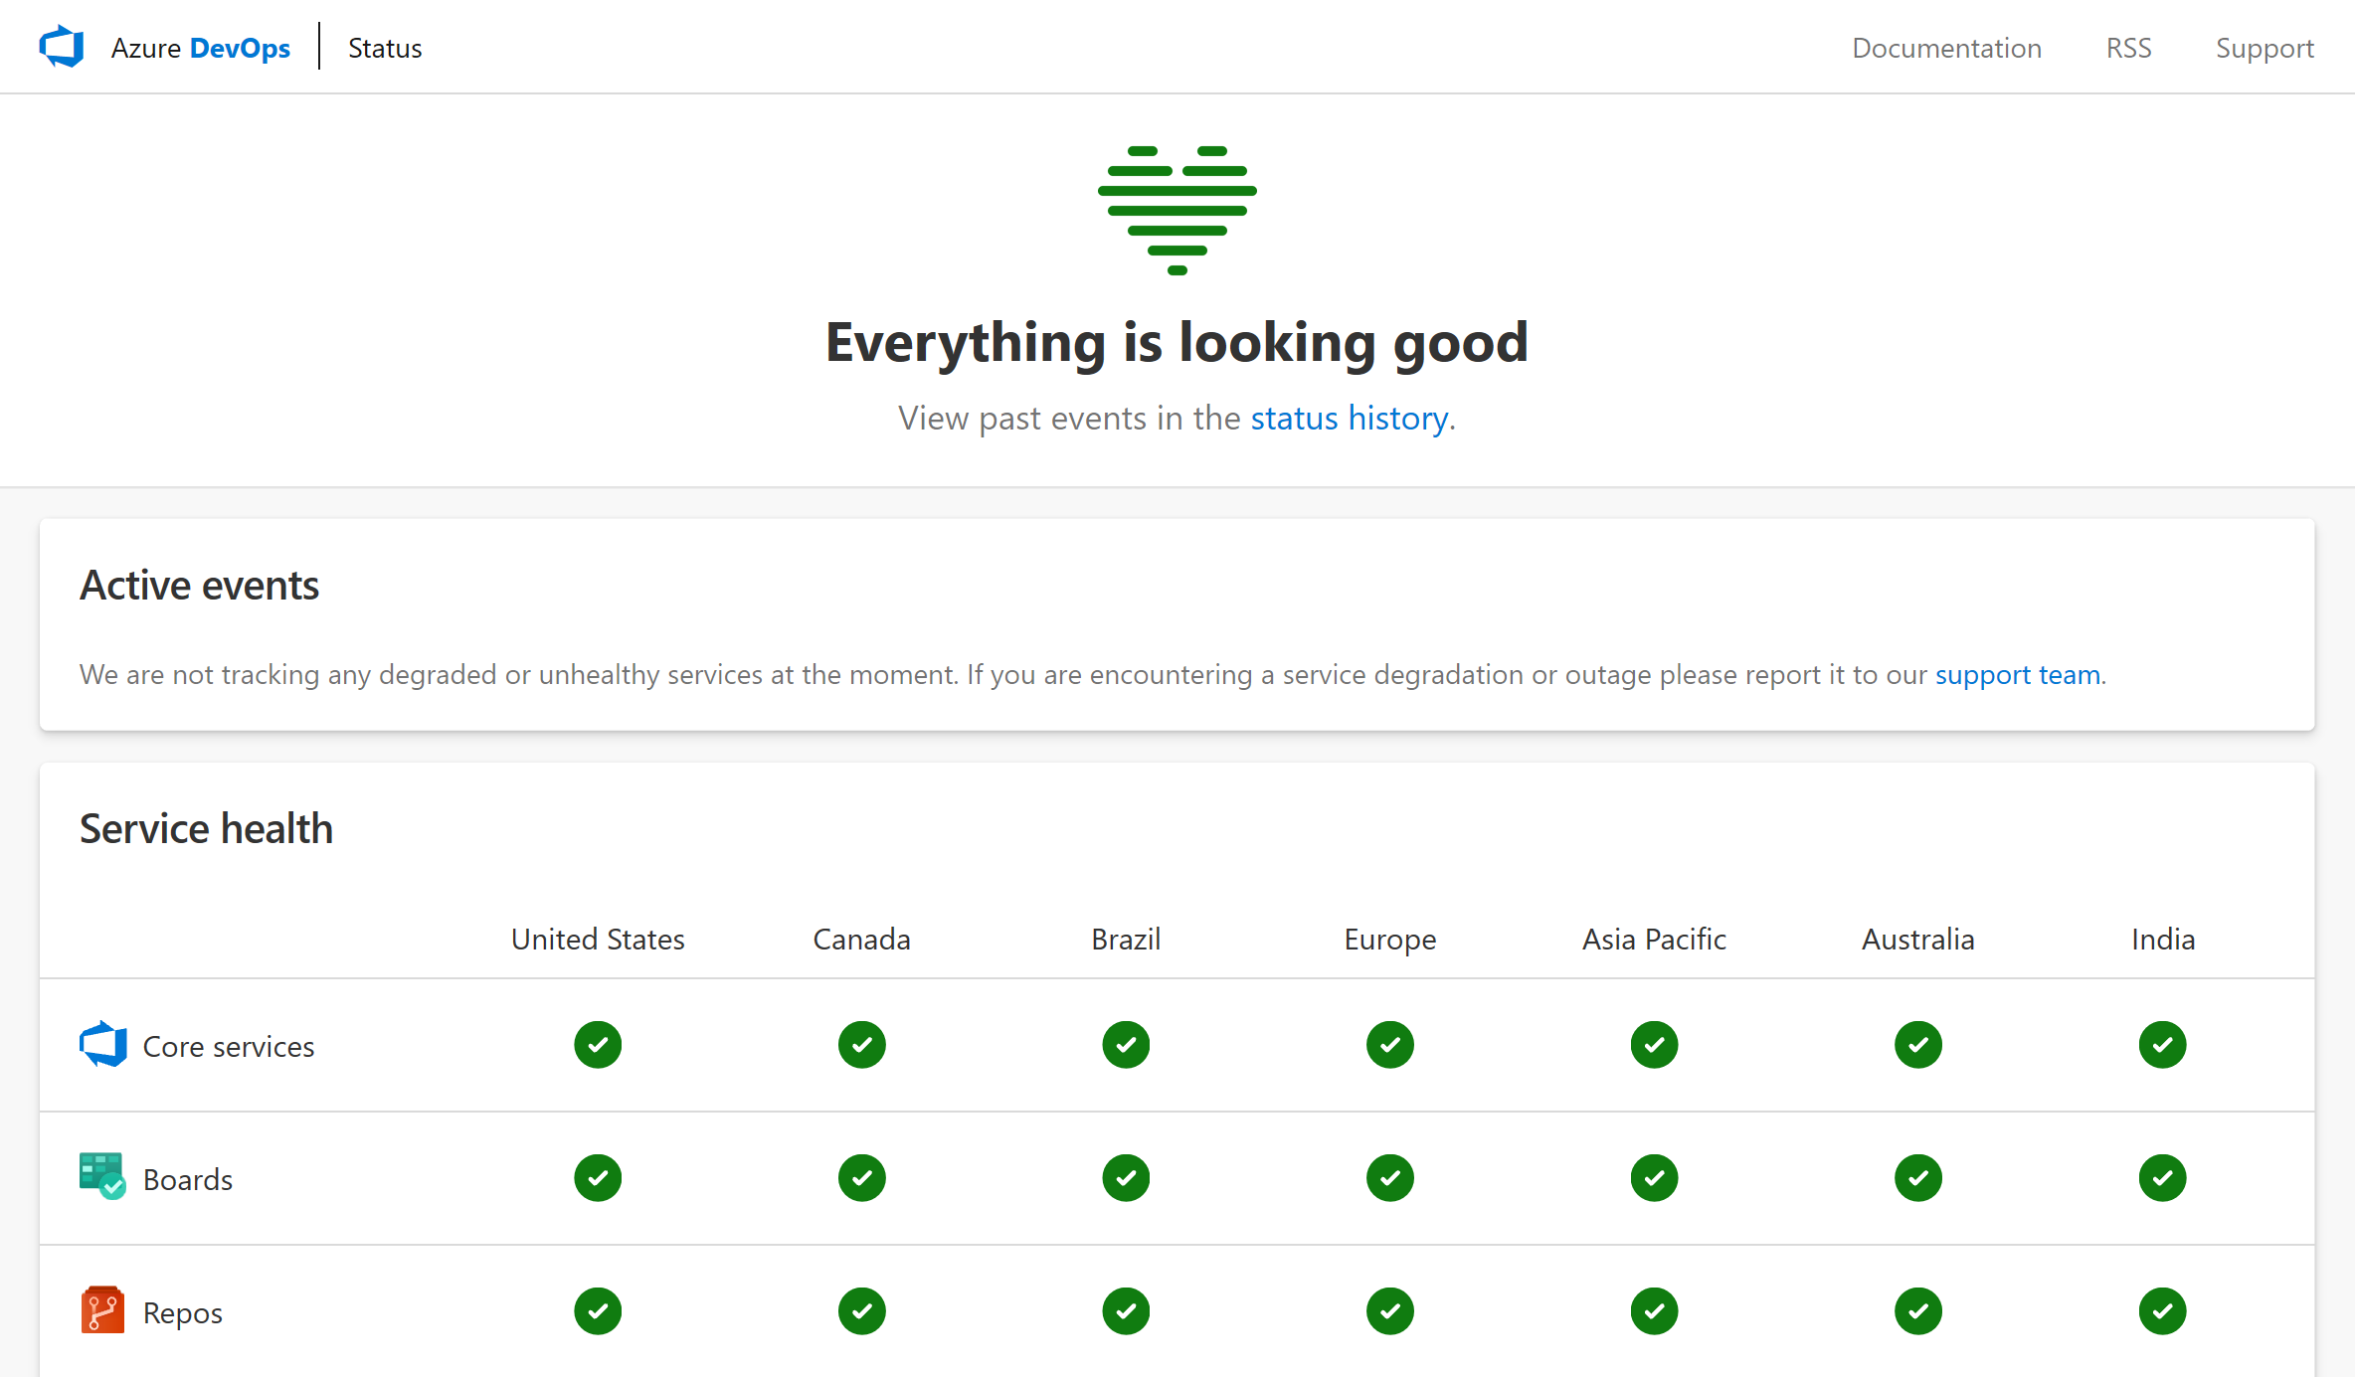
Provide an accurate service status page
https://status.dev.azure.com
Notes:
https://status.dev.azure.com

Slide 22
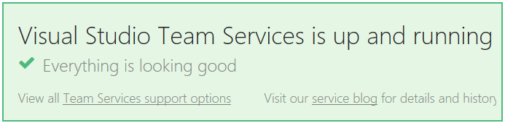
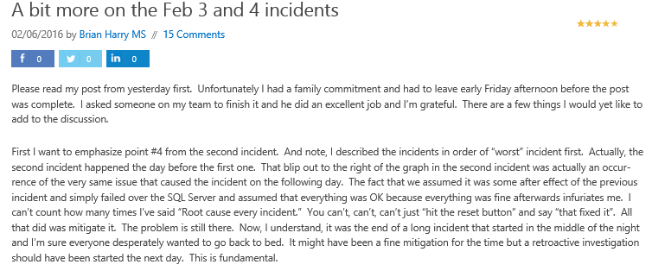
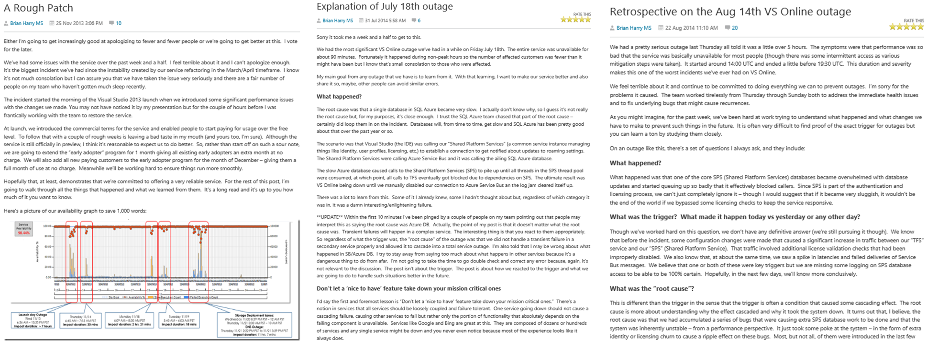
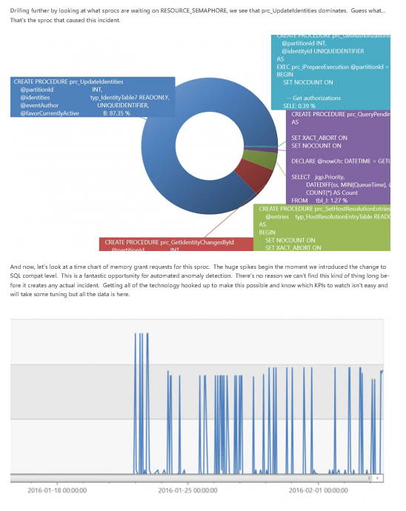
Be Transparent

Slide 23
No such thing as ‘partial automation’
“One time” deployment commands in OneNote, email
Set-Options “-p 0”
Imagine a dozen more steps like that…
And then…someone misses a step half way through
We once broke pre-production for a day

Slide 24
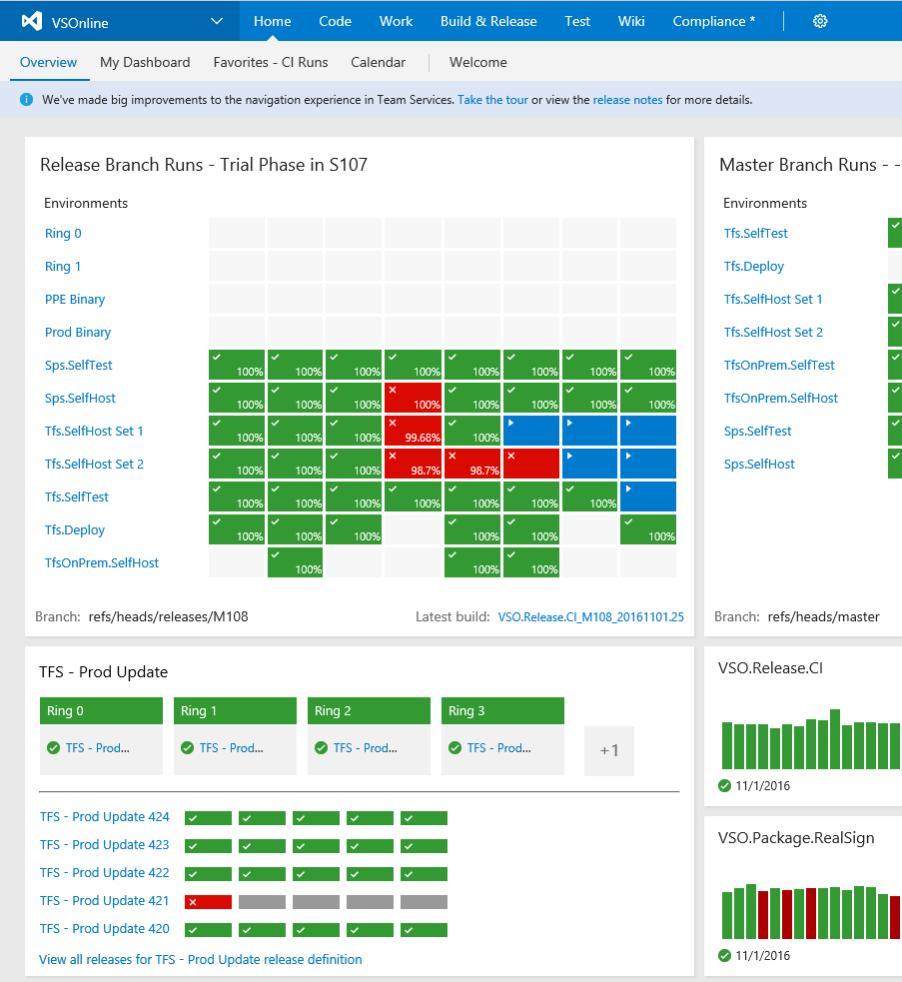
Automate completely
No more “one time” commands run manually
Every command goes in PowerShell scripts that are checked in
Deployment to pre-production & canary is the same as deployment to production every time
All orchestrated with Azure Pipelines

Slide 25
Security Mindset - Assume Breach
Started with war games to the learn attacks and practice response
vs.
Initially double-blind test
Over time, eliminated blue team
Our defenders need to be our defenders
Shifted left to prevent top risks
Credential theft
Secret leakage
OSS vulnerabilities
Notes:
Red Teaming
Shift-Left Security
Threat Modeling
Production Hardening – Azure Security Center, Secrets Management, JIT Admin, DRI Laptops

Slide 26
Five habits we’ve learned so far
Customer Obsessed
Production First Mindset
Team Autonomy + Enterprise Alignment
Shift Left Quality
Safe Deployments and Limiting Damage

Slide 27
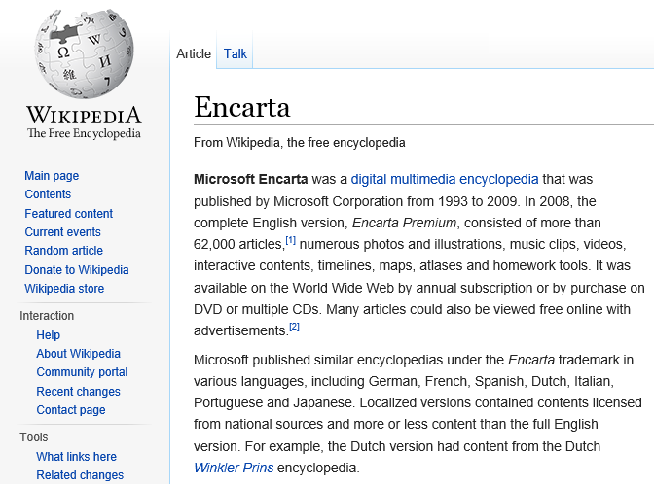


Group A
Business plan
Established in the market
Well funded
Hiring the best people
Group B
Working for free
In their spare time
Because they want to

Slide 28

Agile at Scale with Aligned Autonomy
“Let’s try to give our teams three things…. Autonomy, Mastery, Purpose”
Organization
Roles
Teams
Cadence
Taxonomy
Plan
Practices
Alignment
Autonomy

Slide 29
Roles
The Old Way
Program Management
Dev
Test

Slide 30
Roles
The New Way
Program Management
Engineering

Slide 31
ROLES
WHAT we’re building
WHY we’re building it
HOW we’re building it
Ensure we’re building QUALITY
Program Management
Engineering

Slide 32
TEAMS
WHAT we’re building
WHY we’re building it
HOW we’re building it
Ensure we’re building QUALITY
Program Management
Engineering

Slide 33
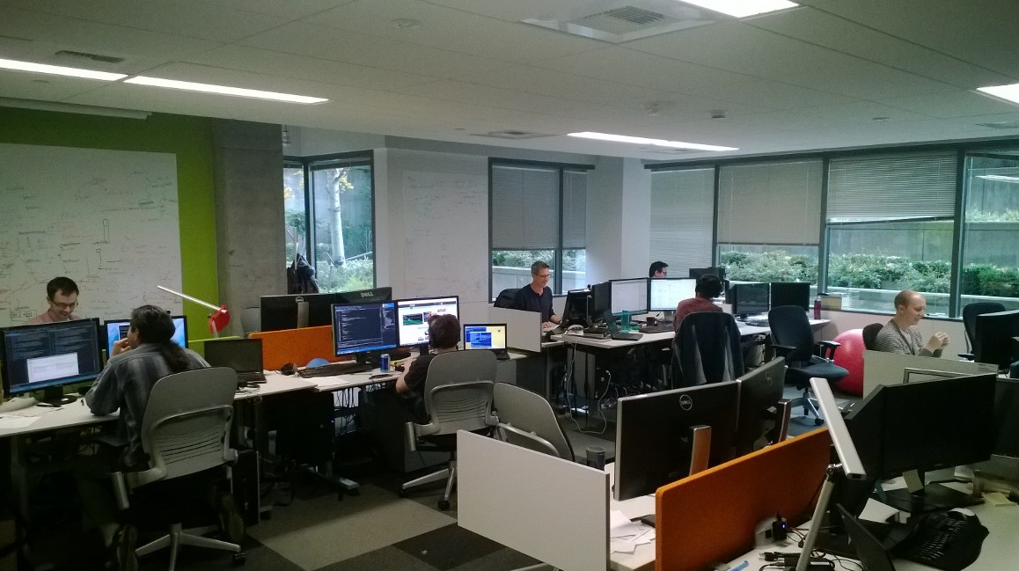
Teams
Physical team rooms
Cross discipline
10-12 people
Self managing
Clear charter and goals
Intact for 12-18 months
Own features in production
Own deployment of features

Slide 34
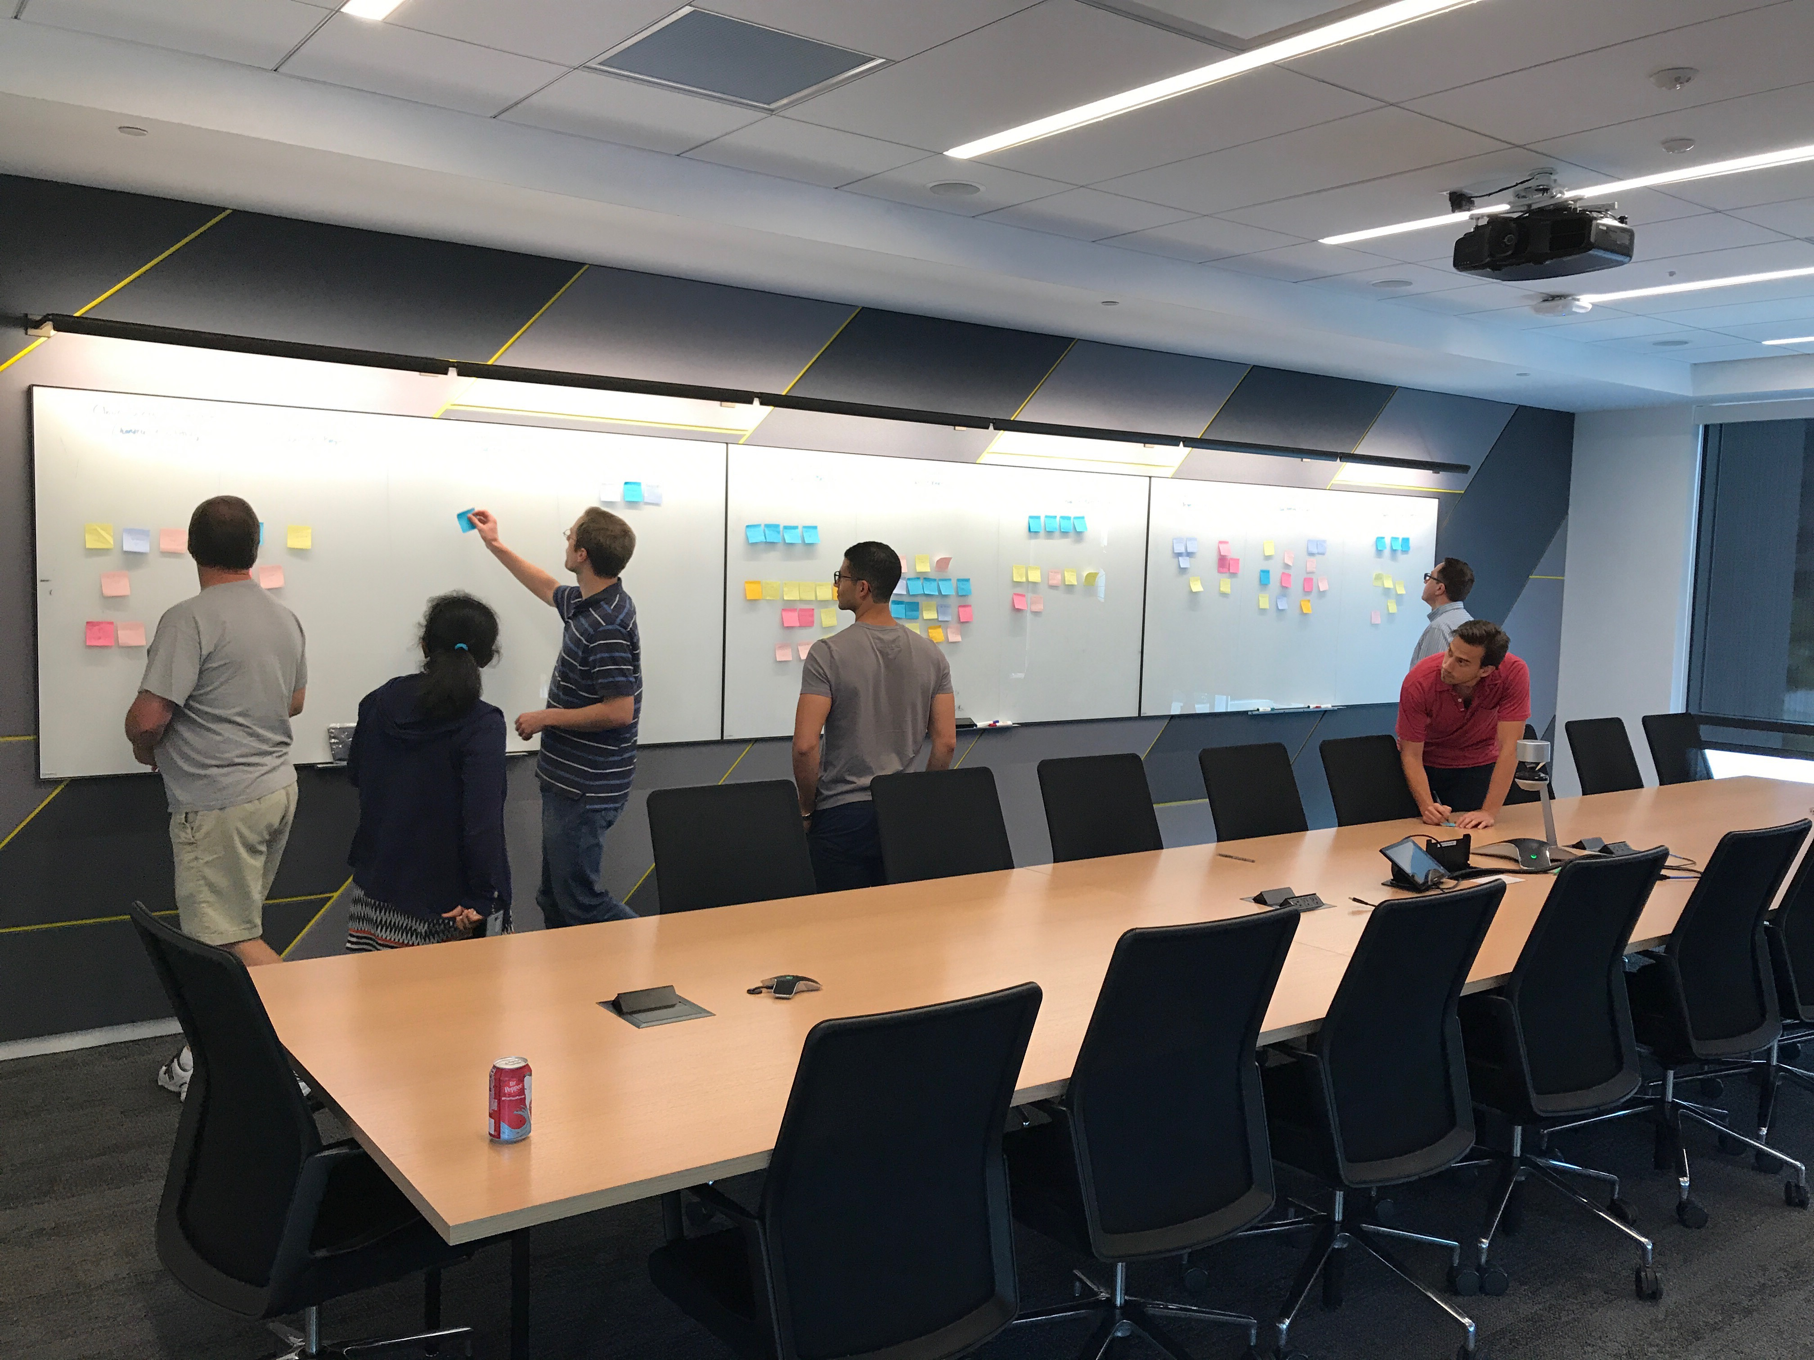
Sticky Note Exercise - Self Forming Teams
Opportunity to change team without formal interviews or top down re-org
Unique approach within Microsoft
Create opportunities for everyone to learn new things
Typically <20% change, but 100% get to make a choice
Employee choice, not manager driven
Cross-pollinate talent and micro-culture

Slide 35
Planning
Leadership is responsible for the big picture
Sprint
3 weeks
Quarter
4 sprints
Semester
6 months
Strategy
12 months
1
4
6
12
Teams are responsible for the detail

Slide 36

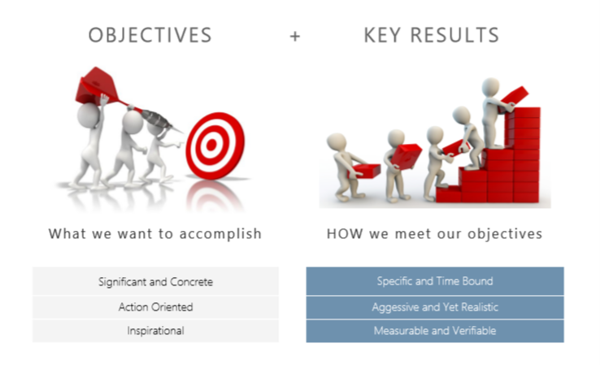
OKRs help promote a Data Driven culture
Resources are prioritized to what moves the needle
Measure how we are progressing toward our goals, adjust if necessary
Transparent end to end organizational alignment
Notes:
Introducing Objectives and Key Results (OKRs)
Objectives and Key Results, or OKRs, are a framework for defining and tracking objectives and their outcomes.

Slide 37
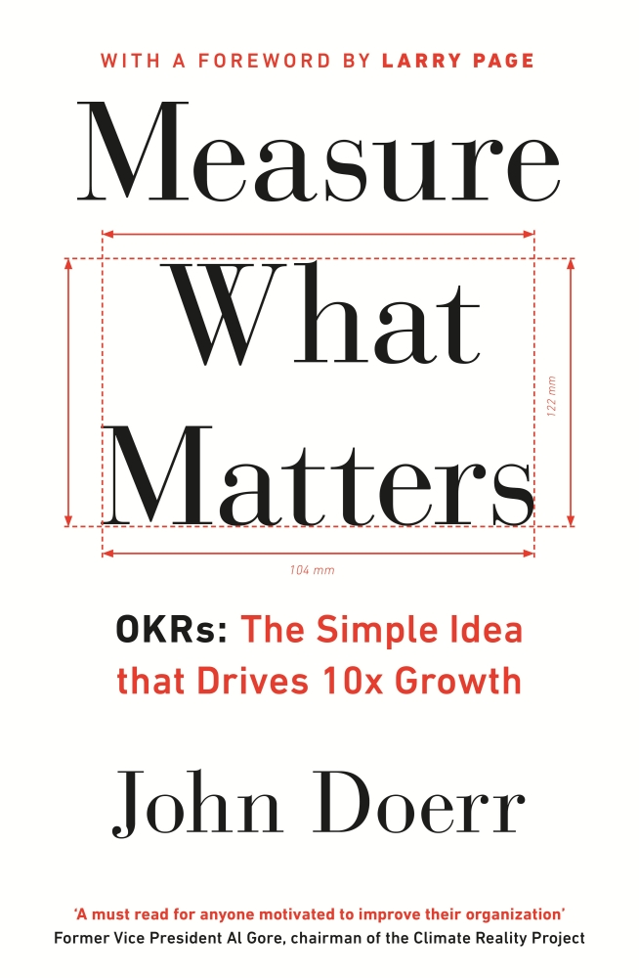
Measure Outcomes not Outputs
OKR: Objective→Key Results
1. Objective: Grow a strong and happy customer base
1.1 Increase external NPS from 21 to 35
1.2 Increase docs SAT from 55 to 65
1.3 New pipeline flow has an Apdex score of 0.9
1.4 Queue time for jobs is 5 seconds or less
KRs are measures for the quarter
Encourage ambitious KRs: 70% of the improvement target scores green

Slide 38
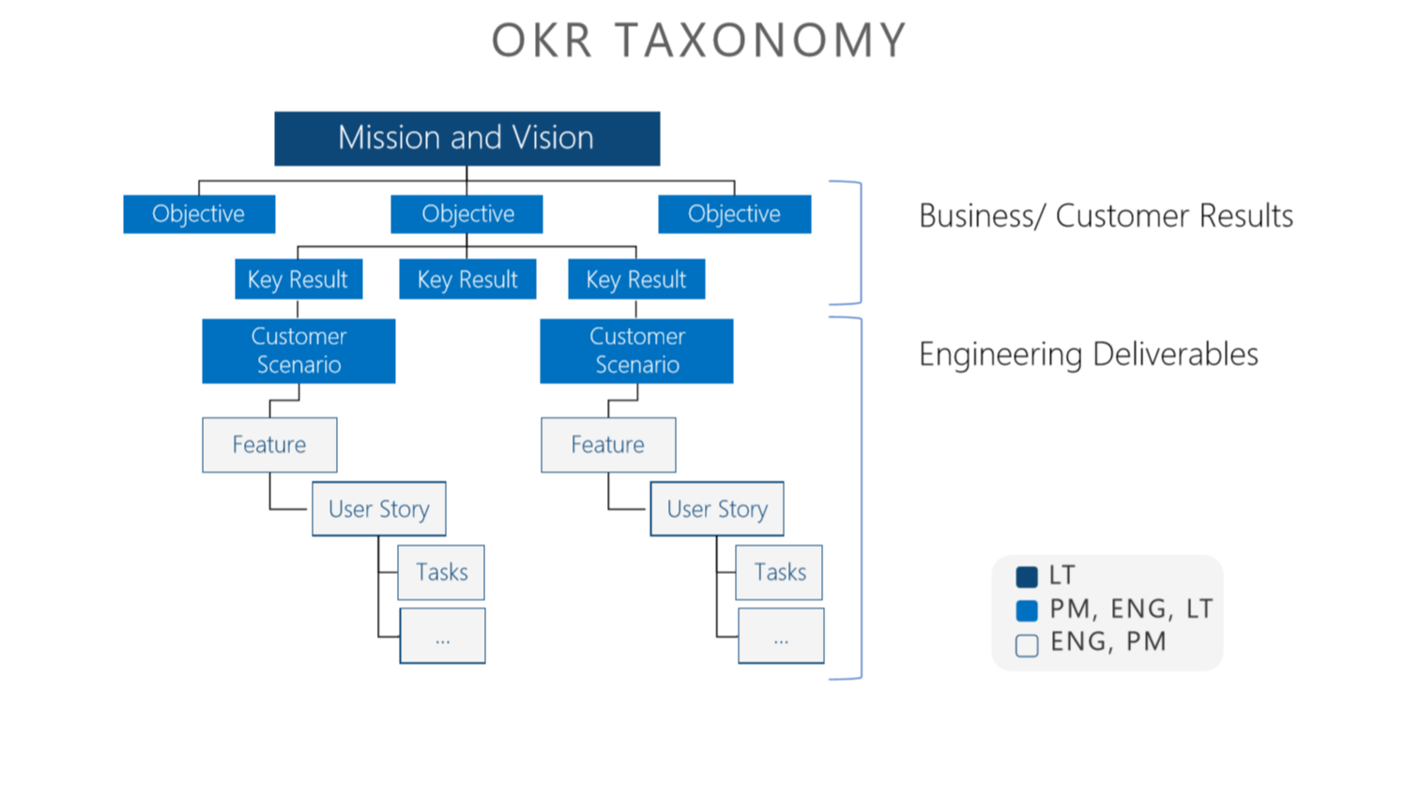

Slide 39
Alignment
Product OKRs
Service OKRs
Service OKRs
Service OKRs
Service OKRs
Service OKRs
Team OKRs
Team OKRs
Team OKRs
Team OKRs
Team OKRs
Team OKRs
Team OKRs
Team OKRs
Team OKRs
Team OKRs
Team OKRs
Team OKRs

Slide 40

How do you stay in sync?
Sprint mail
As needed: Experience Reviews
OKR check 2 sprints
OKR reset 4 sprints
Notes:
We’re going to stop doing all this crazy schedule alignment. We have a single engineering schedule… period. Everyone will use the same language.

Slide 41
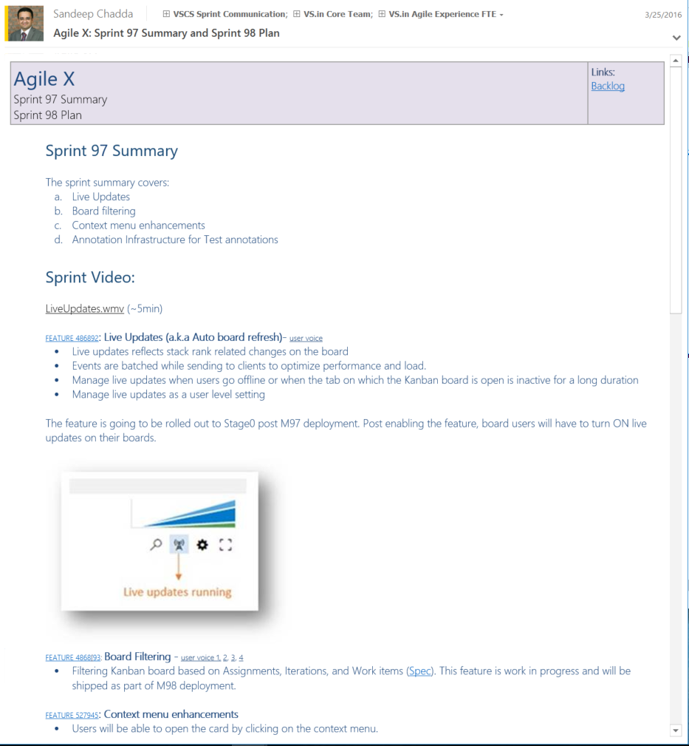
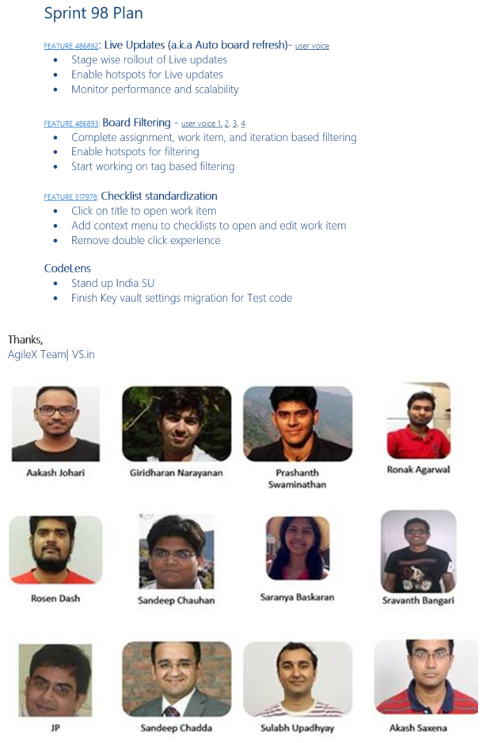
Sprint Mail – Per Crew (1st Six Years)
Value delivered during the sprint by each feature crew
Video demo of the value
What the feature team plans to accomplish in the next sprint
Opportunity to improve
Outputs not outcomes
Too granular for stakeholders
Too many to review well

Slide 42
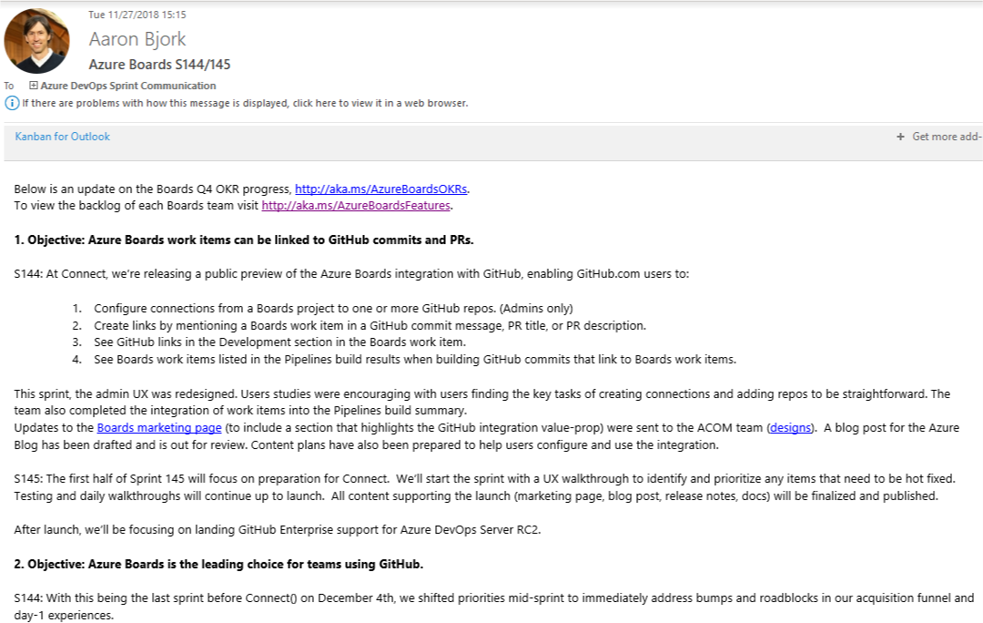
Sprint Mail – Per Epic (Current Practice)
Value delivered against each Objective for Epic
Video by Epic objective, not org structure
Value planned for Epic in next sprint

Slide 43
Five habits we’ve learned so far
Customer Obsessed
Production First Mindset
Team Autonomy + Enterprise Alignment
Shift Left Quality
Safe Deployments and Limiting Damage

Slide 44
Managing the pipeline:
How do you
go fast
and
not
break things?
Notes:
Combined engineering.

Slide 45
Do Not Incur Debt
We all follow a simple rule we call the “Bug Cap”:
#
engineers on your team
x
4
=
?
Notes:
1 bug per dev per day is the average over enough time. Started with 15 and the team just grew to that and stayed there. Limited to 5 so we were 5 – minimum - day from shipping. Maybe it’s more than that because of regressions. Zero Bug Bounce (ZBB)

Slide 46
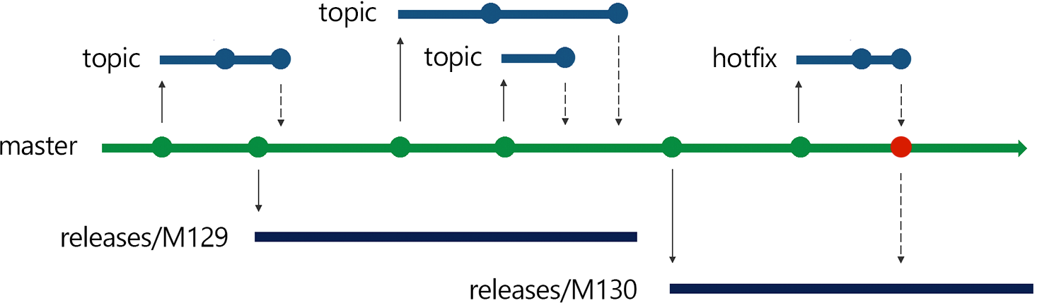
Release Flow
Using Trunk Based Development to avoid Merge Debt
Notes:
DevOps is the union of people, process and products to enable the continuous delivery of value to your end customers

Slide 47
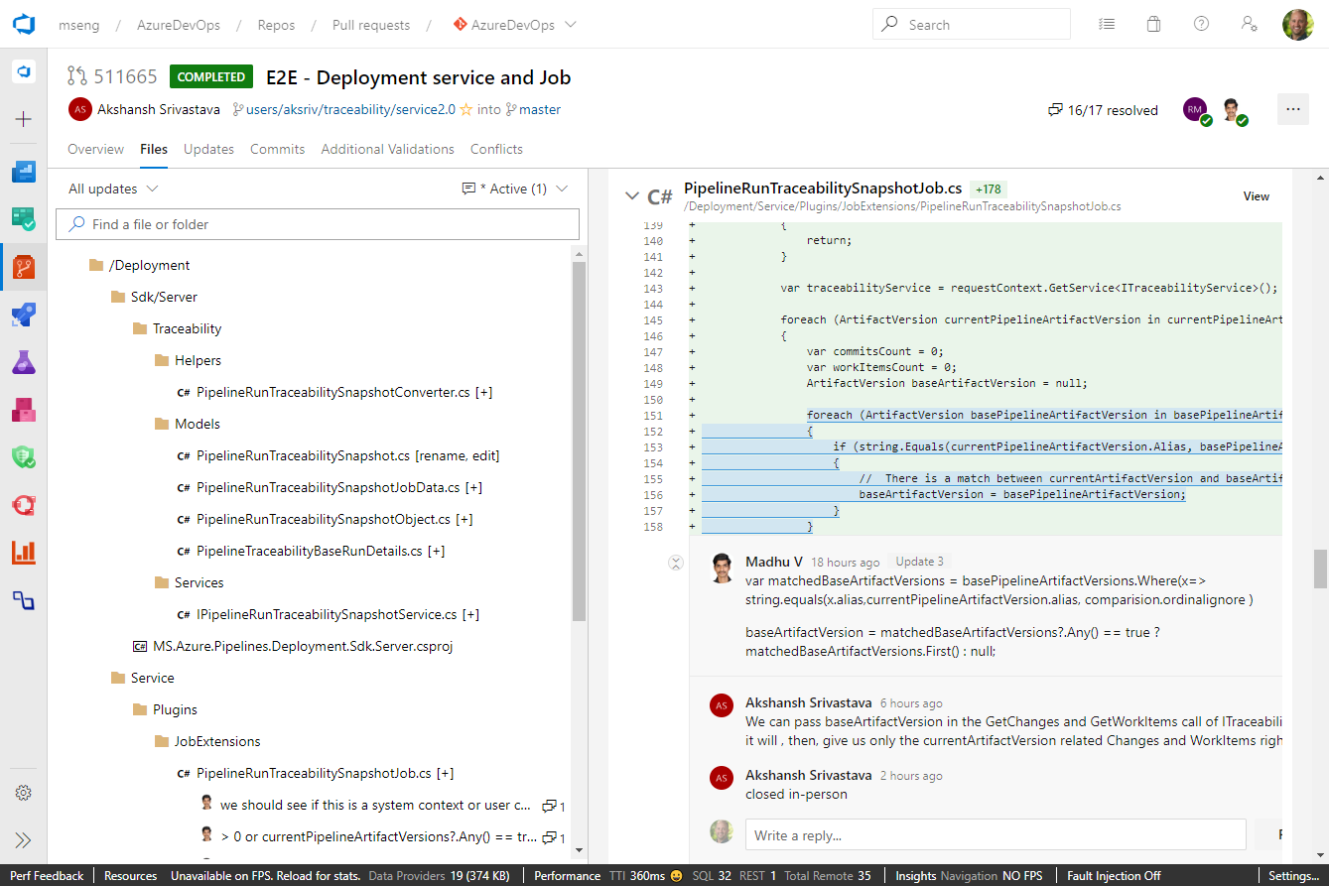
Pull requests
PR’s are point of code review
L0+L1 Tests performed before merge
Security tested before commit
Shift-left testing to pre-merge
1/5 Pull requests fail
Makes CI build failures rare
1/100 CI builds fail
Accelerates the inner and outer loops

Slide 48
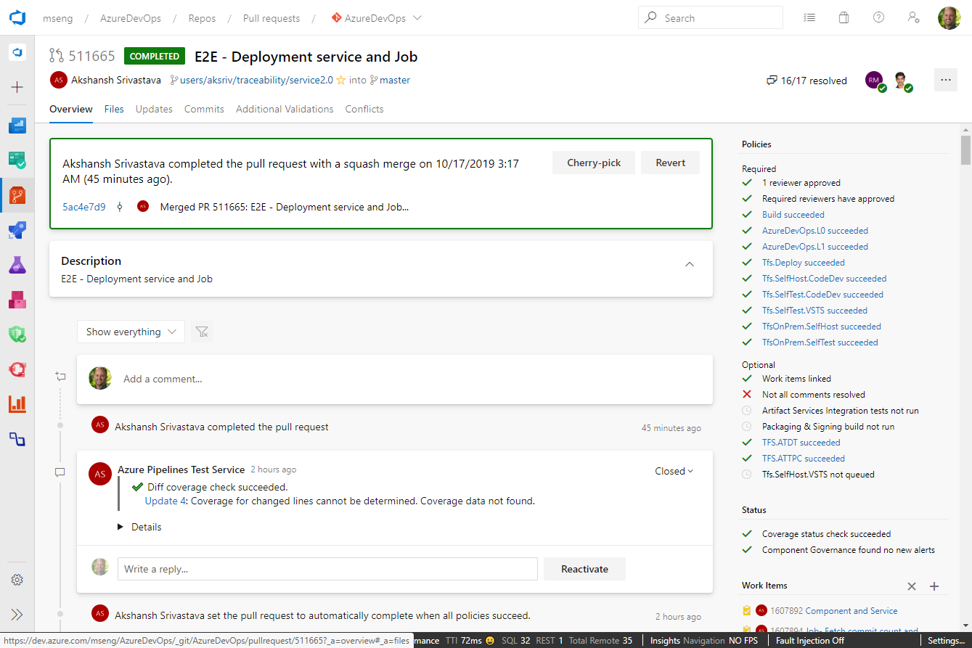
Pull requests
PR’s are point of code review
L0+L1 Tests performed before merge
Security tested before commit
Shift-left testing to pre-merge
1/5 Pull requests fail
Makes CI build failures rare
1/100 CI builds fail
Accelerates the inner and outer loops

Slide 49
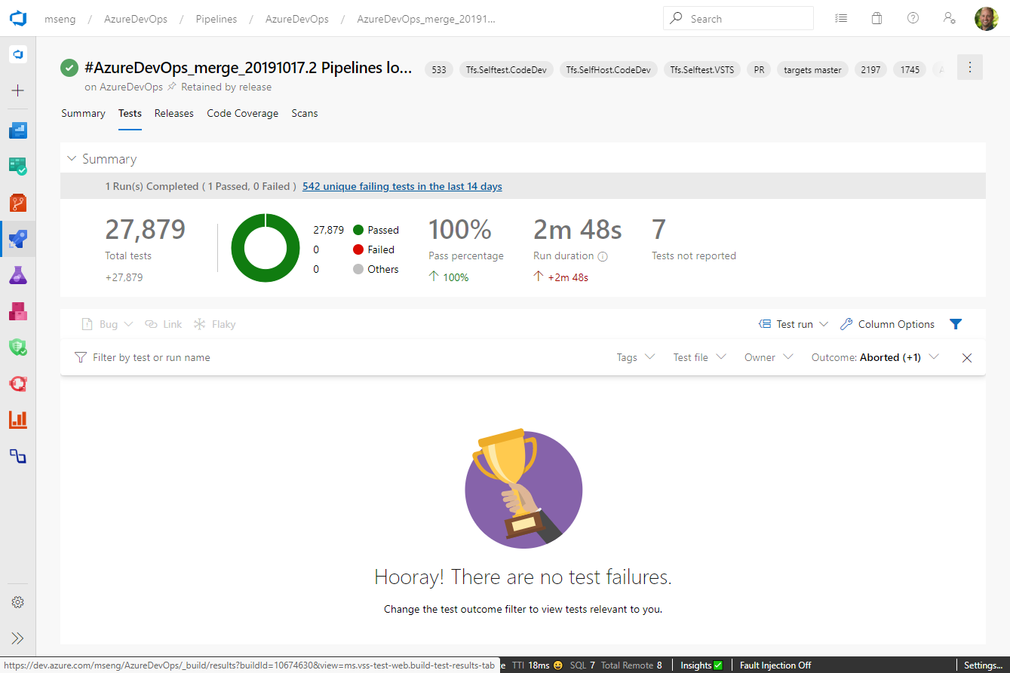
Tests against pull request
Feedback in minutes, before acceptance of PR

Slide 50
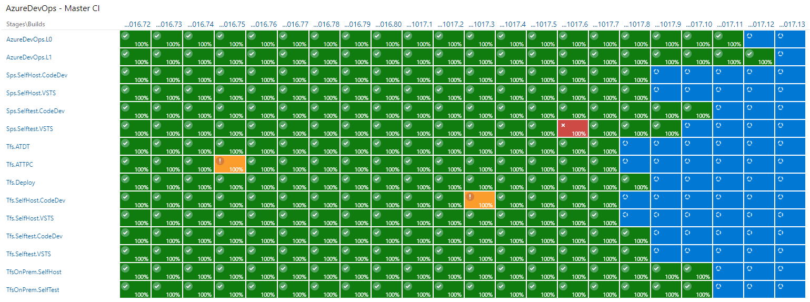
CI: Green Means Green, Red Means Red
Only all-green builds get to release

Slide 51
Created a “Non-Denominational” Test Taxonomy
In-memory unit tests with no dependencies
Unit tests with dependencies e.g. SQL
Functional tests against APIs
PROD
L0
L1
L2
L3
In Pull Request
< 60 ms
< 2000 ms (avg 400 ms)
In pre-prod deployment, with mocked auth
In production rings

Slide 52
Test portfolio over time

Slide 53
Test portfolio over time
TYPE | M78 | M144 | DELTA
L0 | 2723 | 77590 | + 74,867
L1 |  | 6906 | + 6,906
L2 |  | 6851 | + 6,851
TRA | 27054 | 0 | - 27,054

Slide 54
Five habits we’ve learned so far
Customer Obsessed
Production First Mindset
Team Autonomy + Enterprise Alignment
Shift Left Quality
Safe Deployments and Limiting Damage

Slide 55
Your aim won’t be perfect. Control the blast radius.
4
3
2
1
0
Notes:
Progressive Exposure

Slide 56
Early Principles
The same tools we use to deploy to production we use in dev and test environments
The quality signals we look at to green light deployments are tracked constantly every day
Deployments take zero down time
Deployments happen during working hours
No ‘partial’ automation

Slide 57
What do feature flags give us?
Decouple deployment and exposure
Flags provide runtime control down to individual user
Change without redeployment
Controlled via PowerShell or web UI
Support early feedback, experimentation
Quick off switch

Slide 58
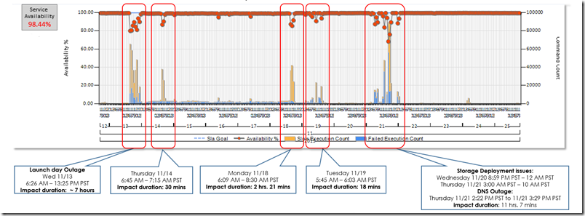
Awesome! What could go wrong?
Features to be revealed at big event
We turned features on globally just before the keynote...
It didn’t go well.

Slide 59
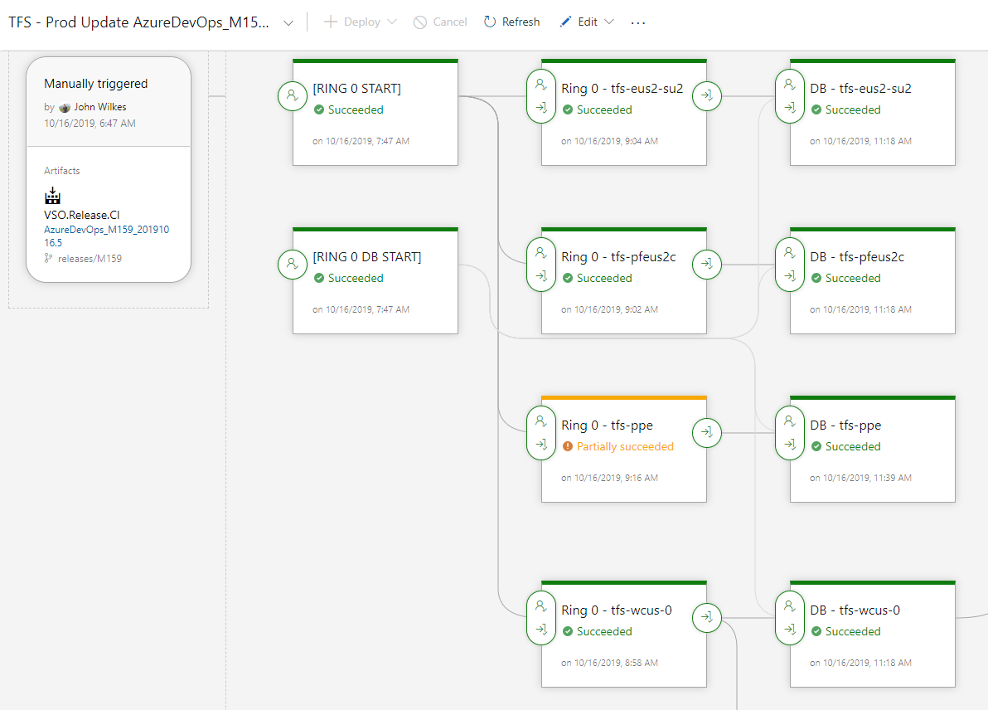
Progressive Exposure
Deploy one stage at a time
Release Gates control progression
Automated (L3) tests to check current ring
Can slow down with explicit approval
Visibility into impact of every deployment
Move across
Canary
Data centers with small user counts
Data center with large user count
Highest latency
The rest

Slide 60
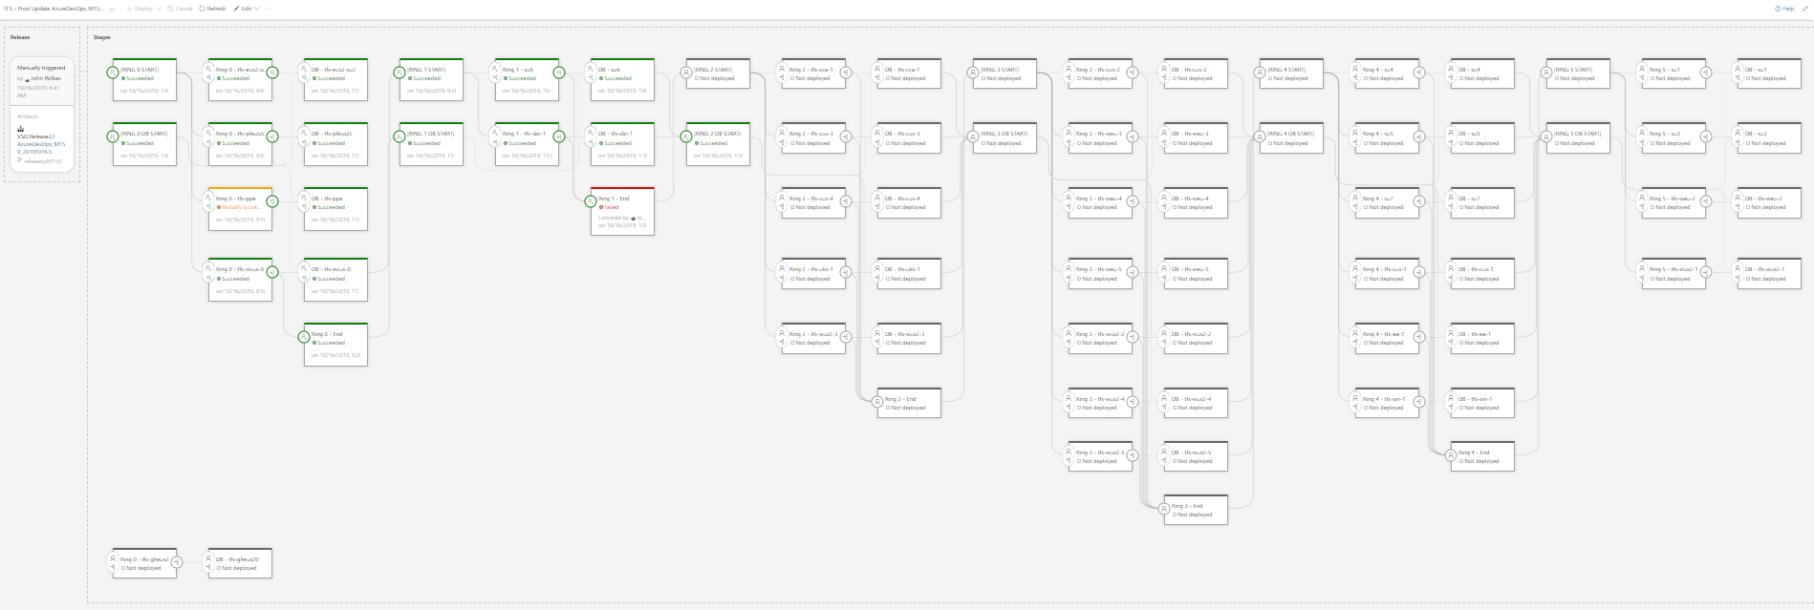
Progressive Exposure

Slide 61
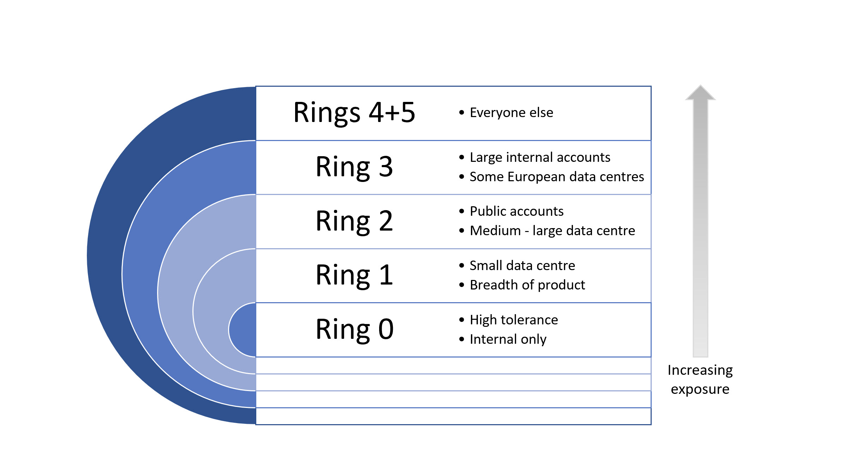
Deployment rings

Slide 62
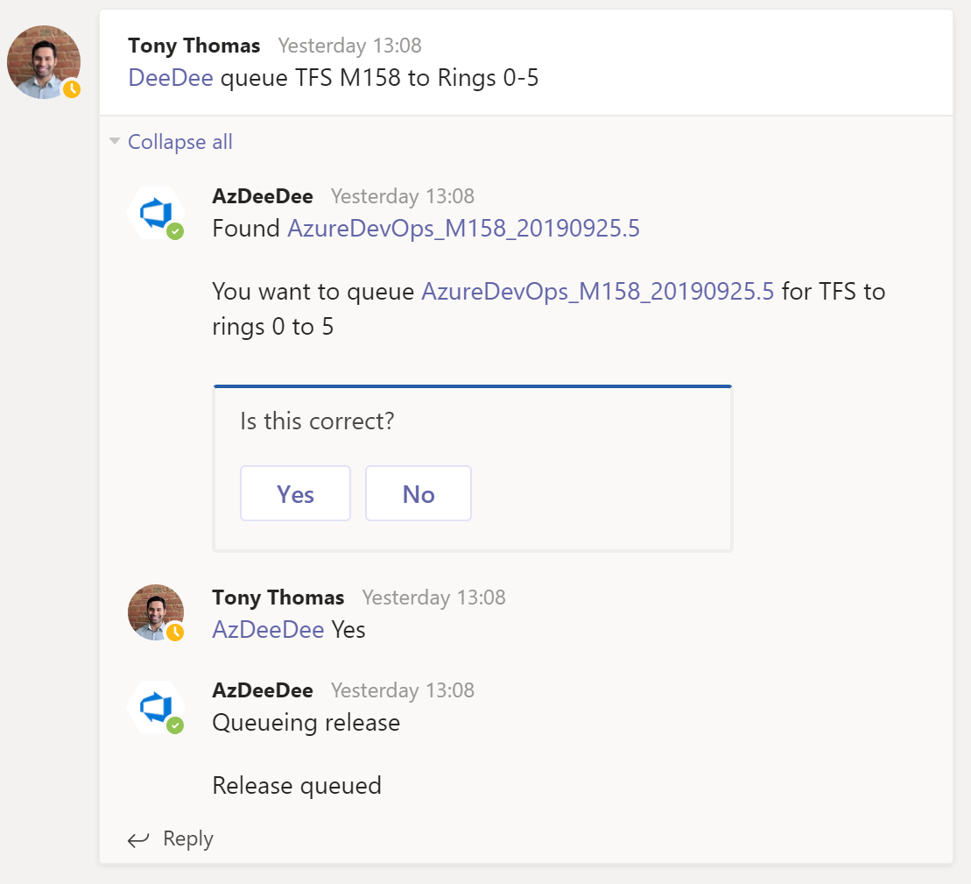
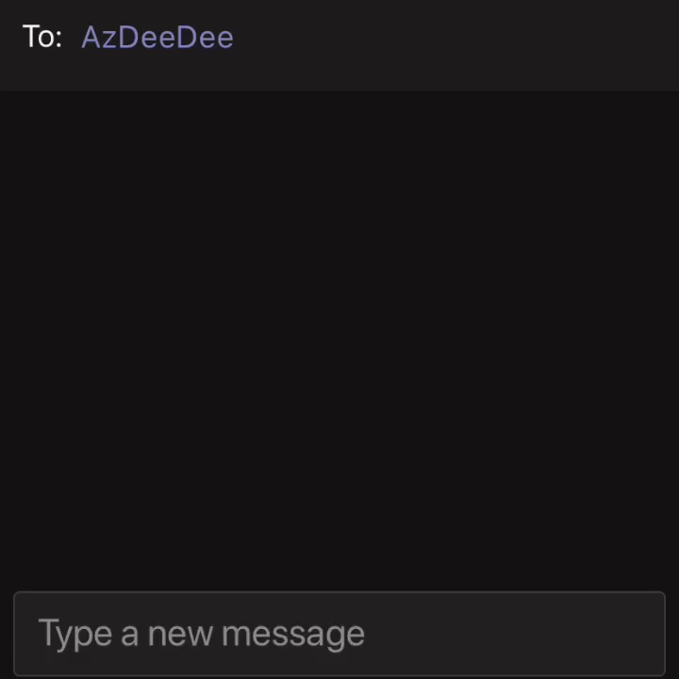

Slide 63
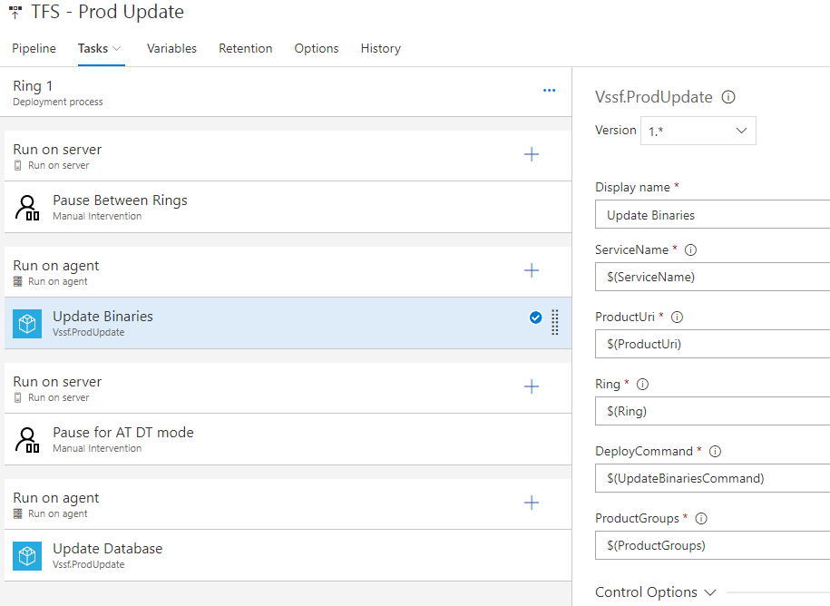
Ring definition
Delays are achieved via manual intervention tasks
configured to continue after the delay
All the heavy lifting is done by this custom command line tool,
Which is the same tool we use to deploy in dev and test environments

Slide 64
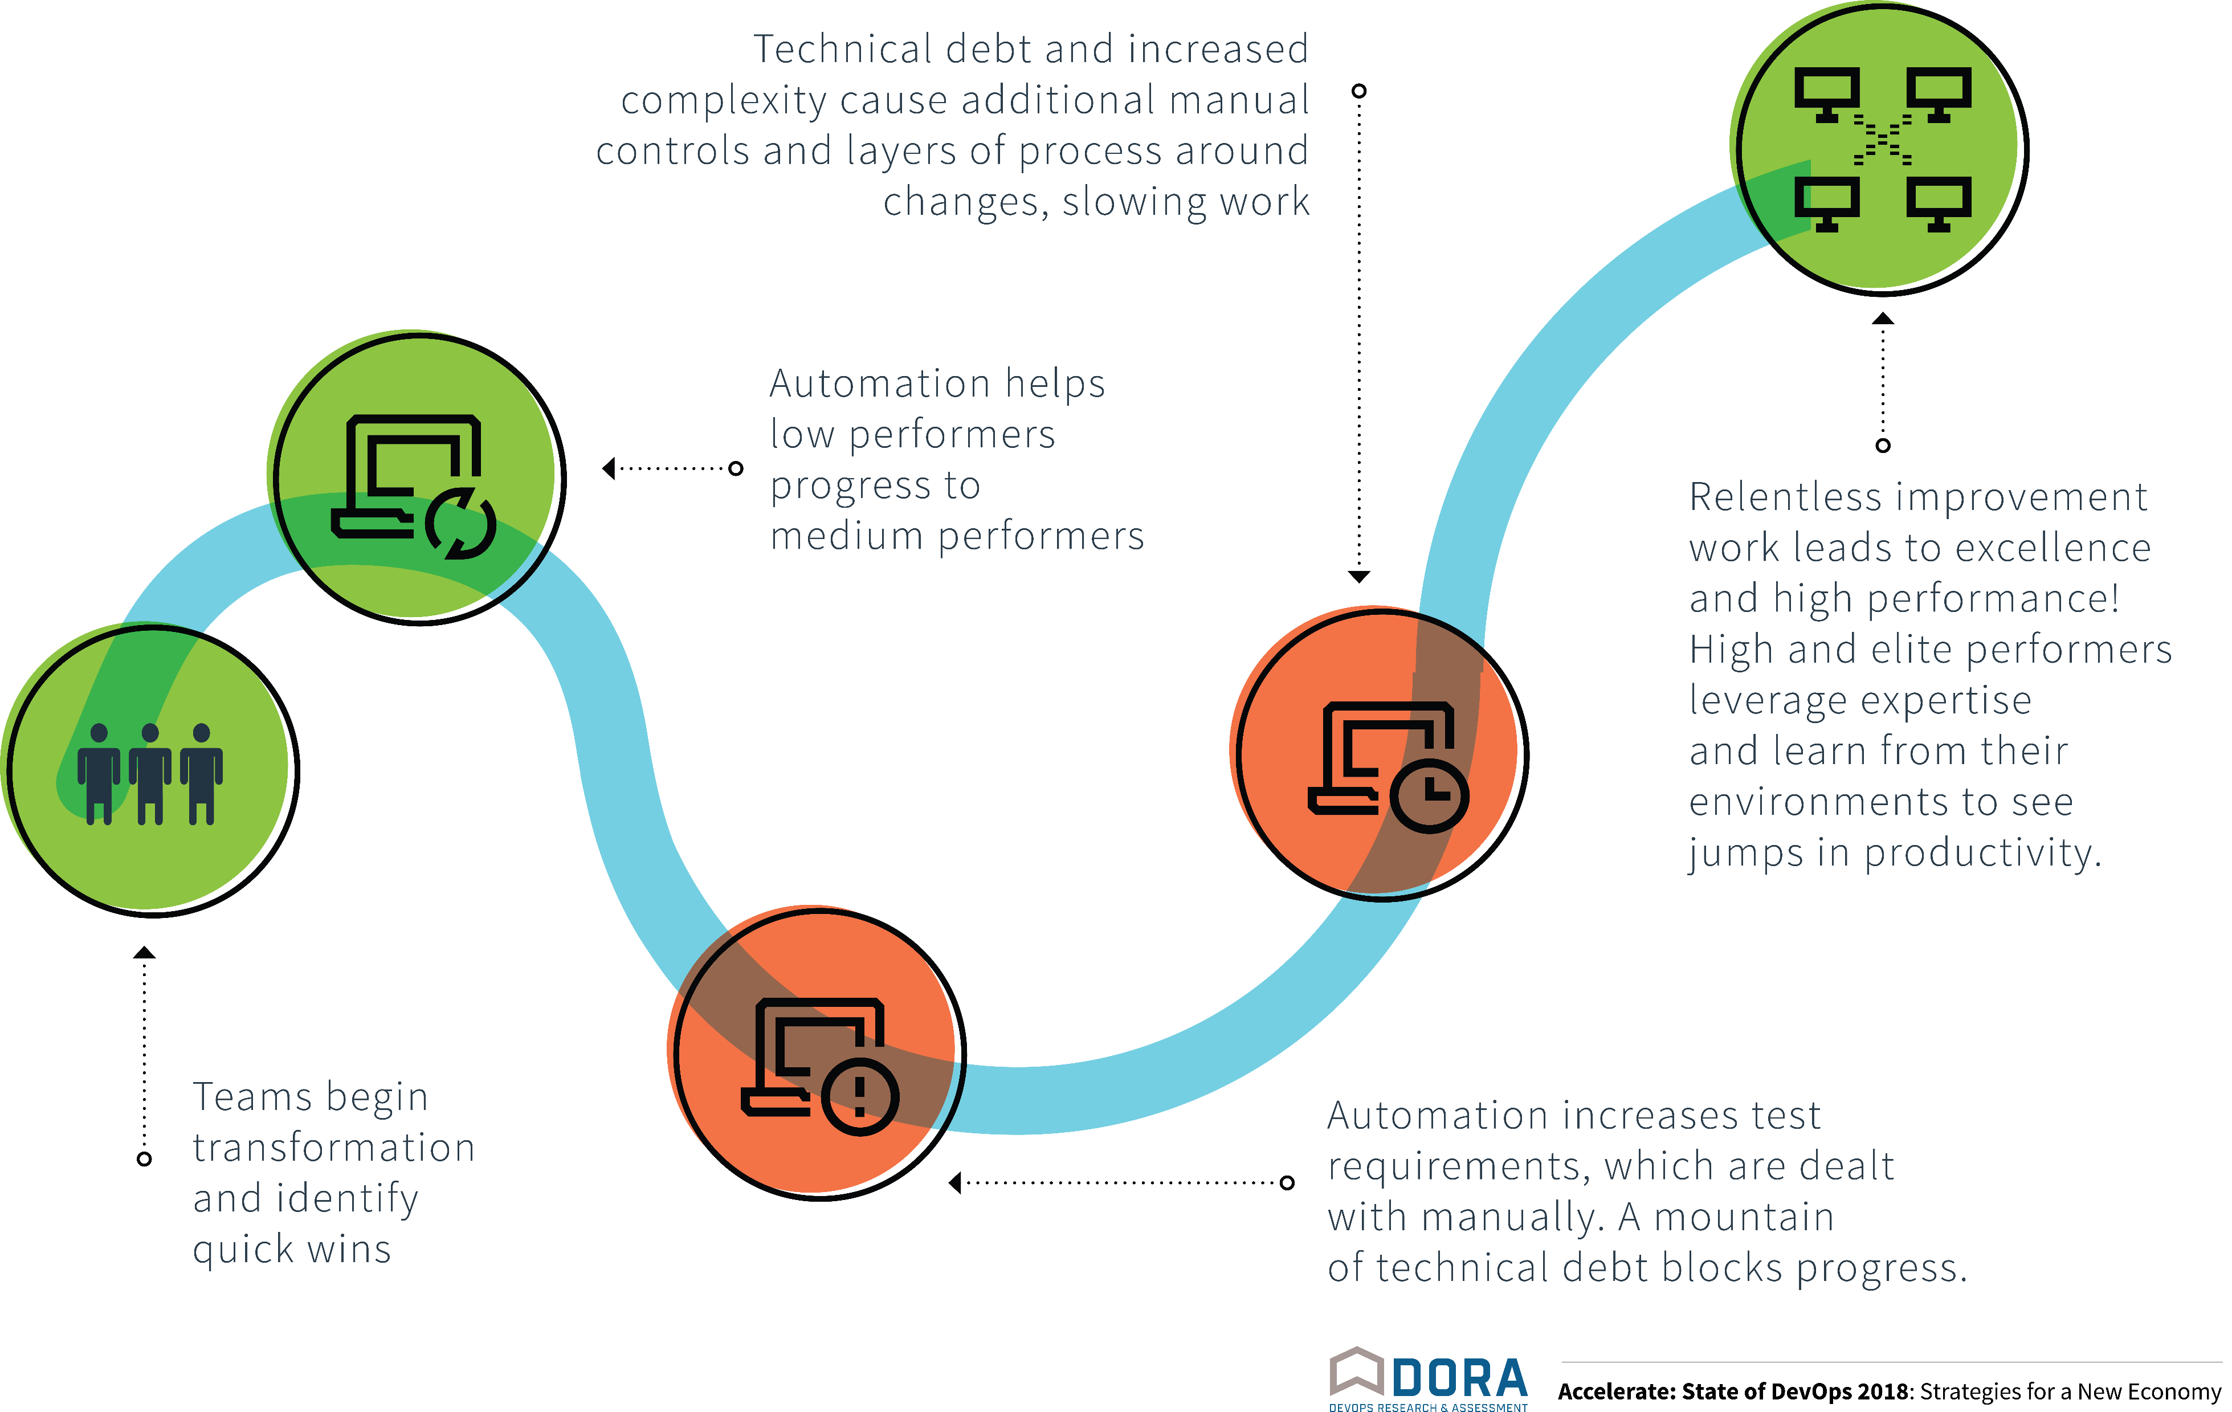
Progress follows a J-curve

Slide 65
The journey so far
VSTS Preview
1ES
Windows on Git
Azure Pipelines
Sprint 140
Sep 2018
Sprint 1
August 2010
Sprint 29
June 2012
Sprint 67
June 2014
Sprint 102
May 2017
2010
2011
2012
2013
2014
2015
2016
2017
2018
2019
2020
400 Open Source Projects
Microsoft on GitHub
VS Code
GitHub Acquired
March 2010
July 2014
April 2015
Join Linux Foundation
Nov 2016
Oct 2018

Slide 66
What’s next?
VSTS Preview
1ES
Windows on Git
Azure Pipelines
Sprint 140
Sep 2018
Sprint 1
August 2010
Sprint 29
June 2012
Sprint 67
June 2014
Sprint 102
May 2017
2010
2011
2012
2013
2014
2015
2016
2017
2018
2019
2020
Inner source with GitHub
Shift-left with security & compliance
Resilience / Chaos engineering practices
400 Open Source Projects
Microsoft on GitHub
VS Code
GitHub Acquired
March 2010
July 2014
April 2015
Join Linux Foundation
Nov 2016
Oct 2018

Slide 67

The journey has its ups and down,
but in the end it’s worth it

Slide 68
Features Delivered per Year
Our DevOps transformation has allowed our team to deliver more value to our customers at an increasing velocity.
Removing “taxes on the team” allowed us to ship more features in 2016 (262) than the previous 4 years combined (256 features).
364 features in 2017!
What happened in 2018?
GDPR compliance work (Global service)
Azure DevOps re-architecture (Individual services)
https://docs.microsoft.com/en-us/azure/devops/release-notes/index

Slide 69

Thank you
mickey.gousset@microsoft.com
@mickey_gousset
https://www.linkedin.com/in/mickeygousset/

Slide 70
DevOps CAT team mission
Work with Microsoft’s largest customers to help them accelerate their DevOps transformation.

Slide 71

Me
Mickey Gousset
Joined Microsoft June-18
Dev Tools MVP - 14 years
Tupelo, Mississippi, USA
@mickey_gousset
mickeygousset.com
mickey.gousset@microsoft.com
https://youtube.com/mickeygousset

